Slide 1
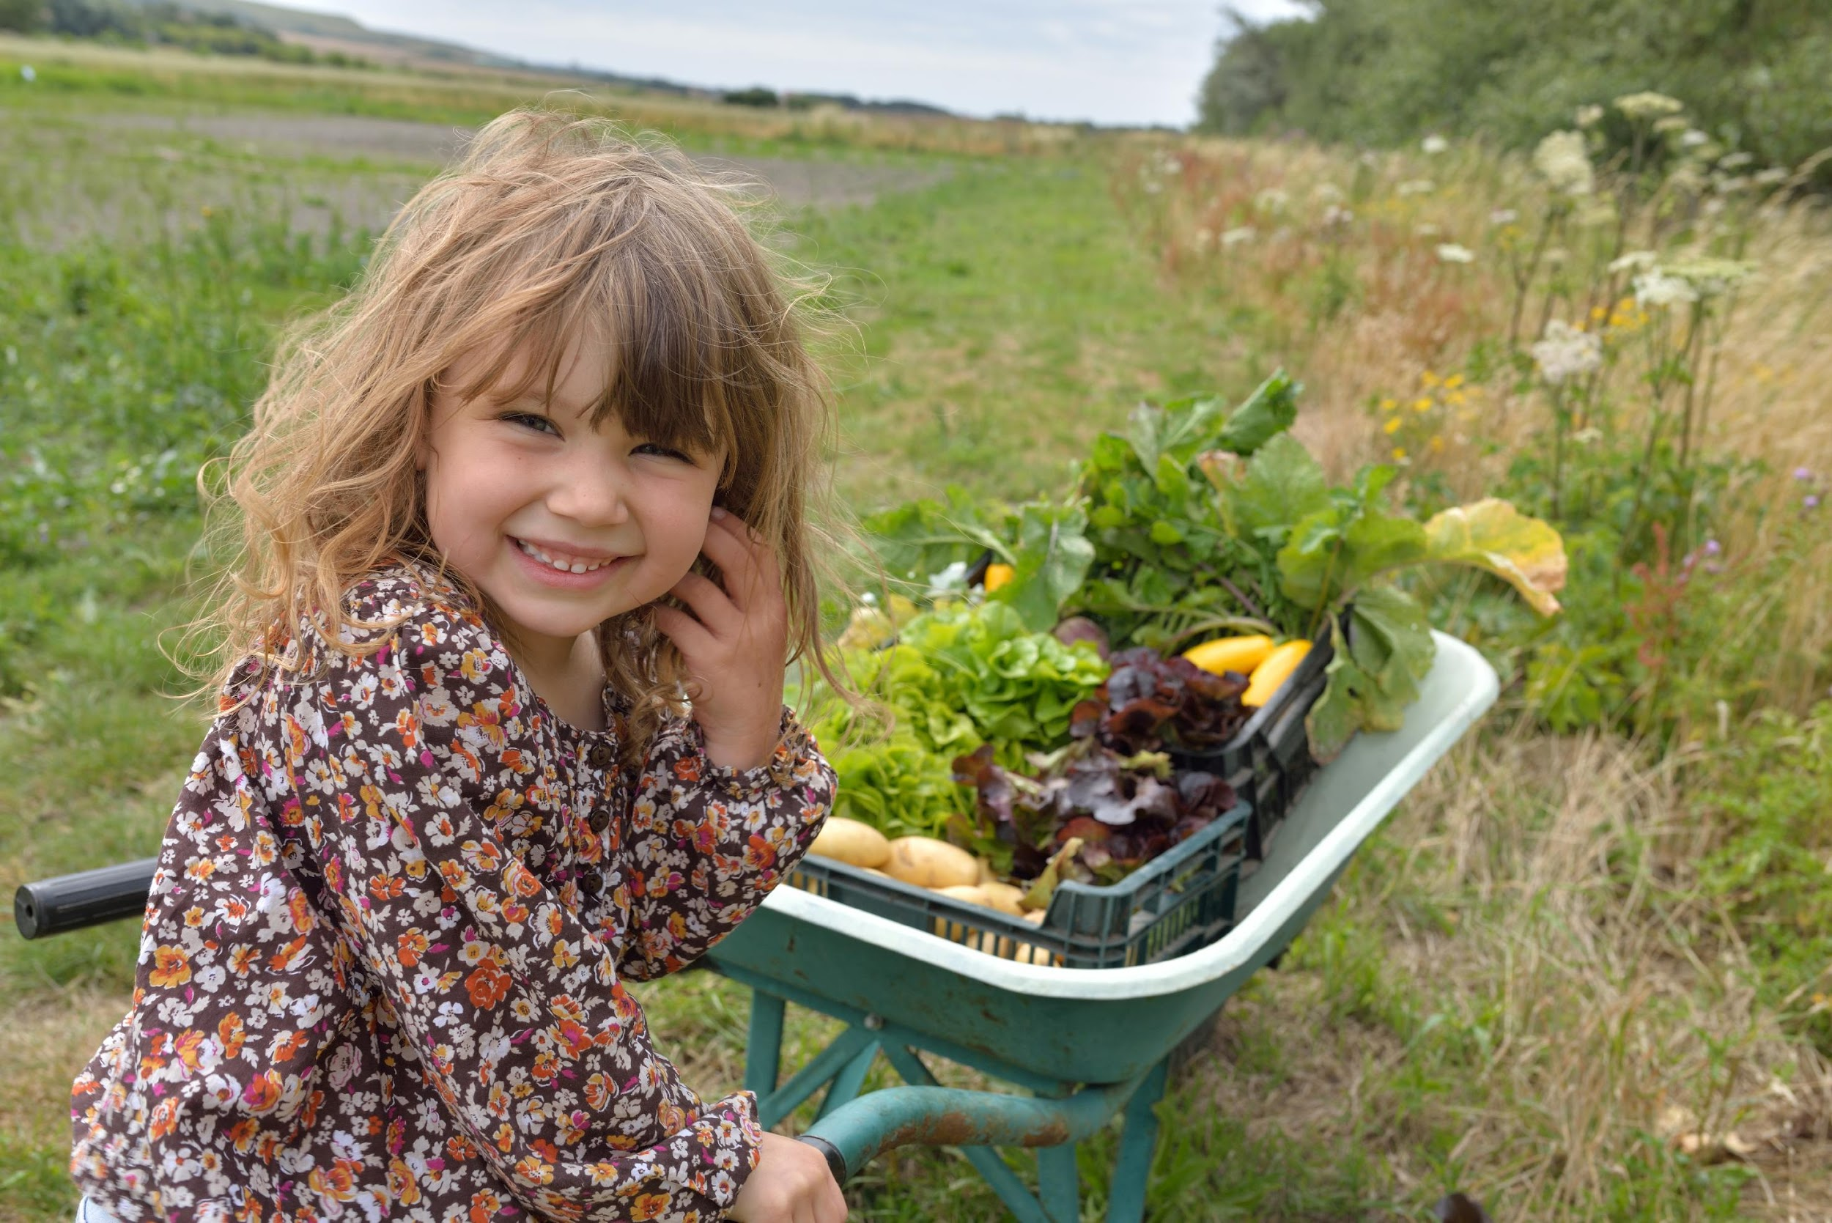
Lesson #2
Fuel Your Engine
High-Quality Fuel!

Slide 2
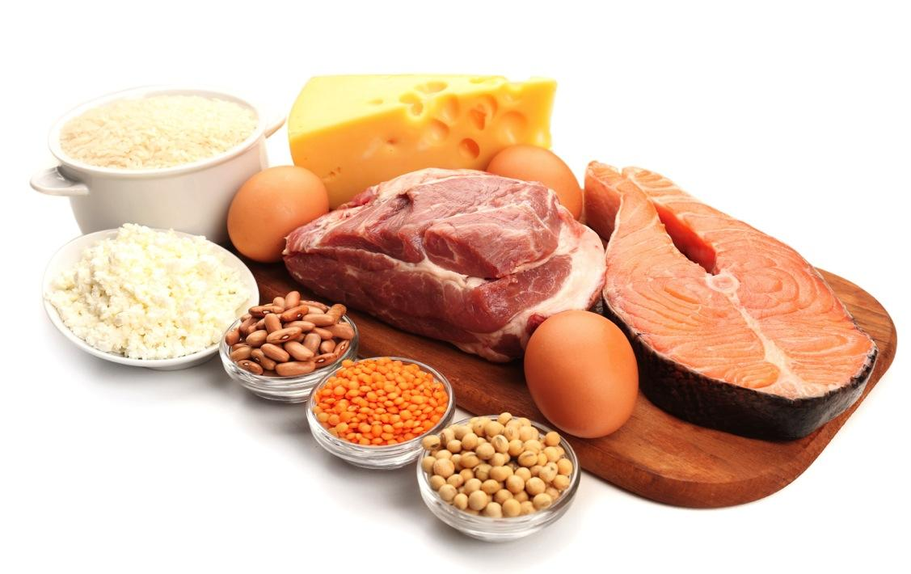
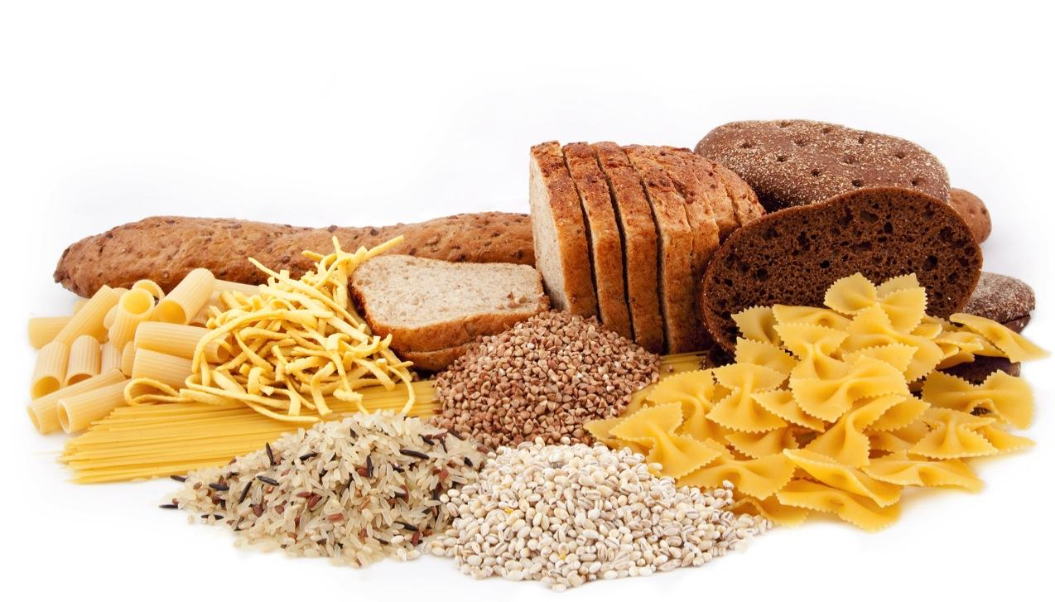
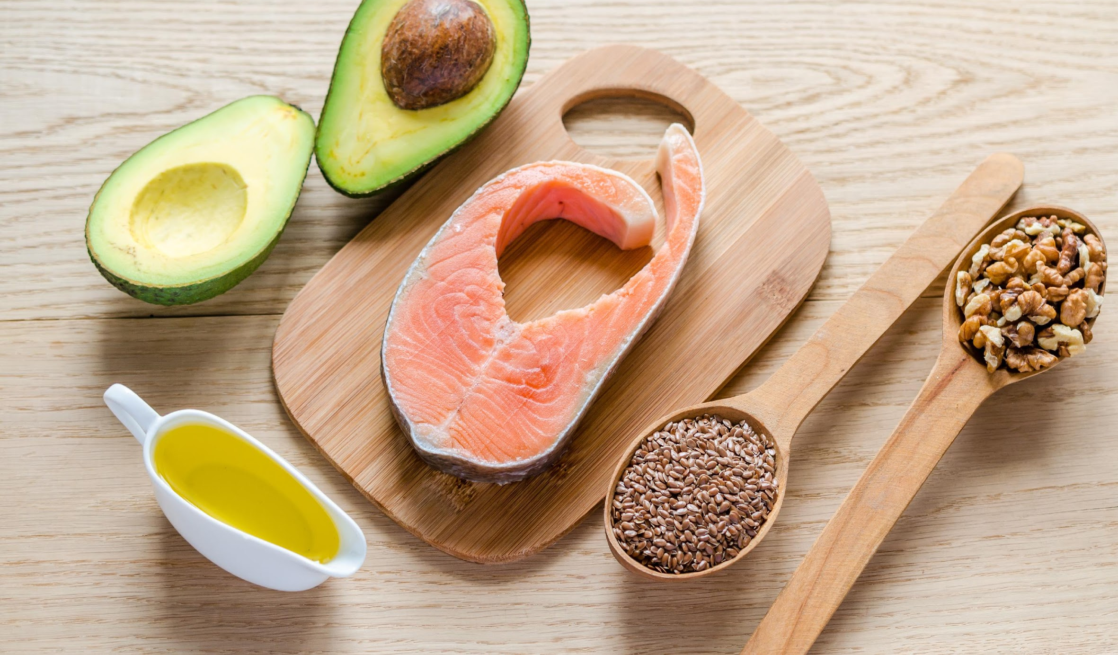
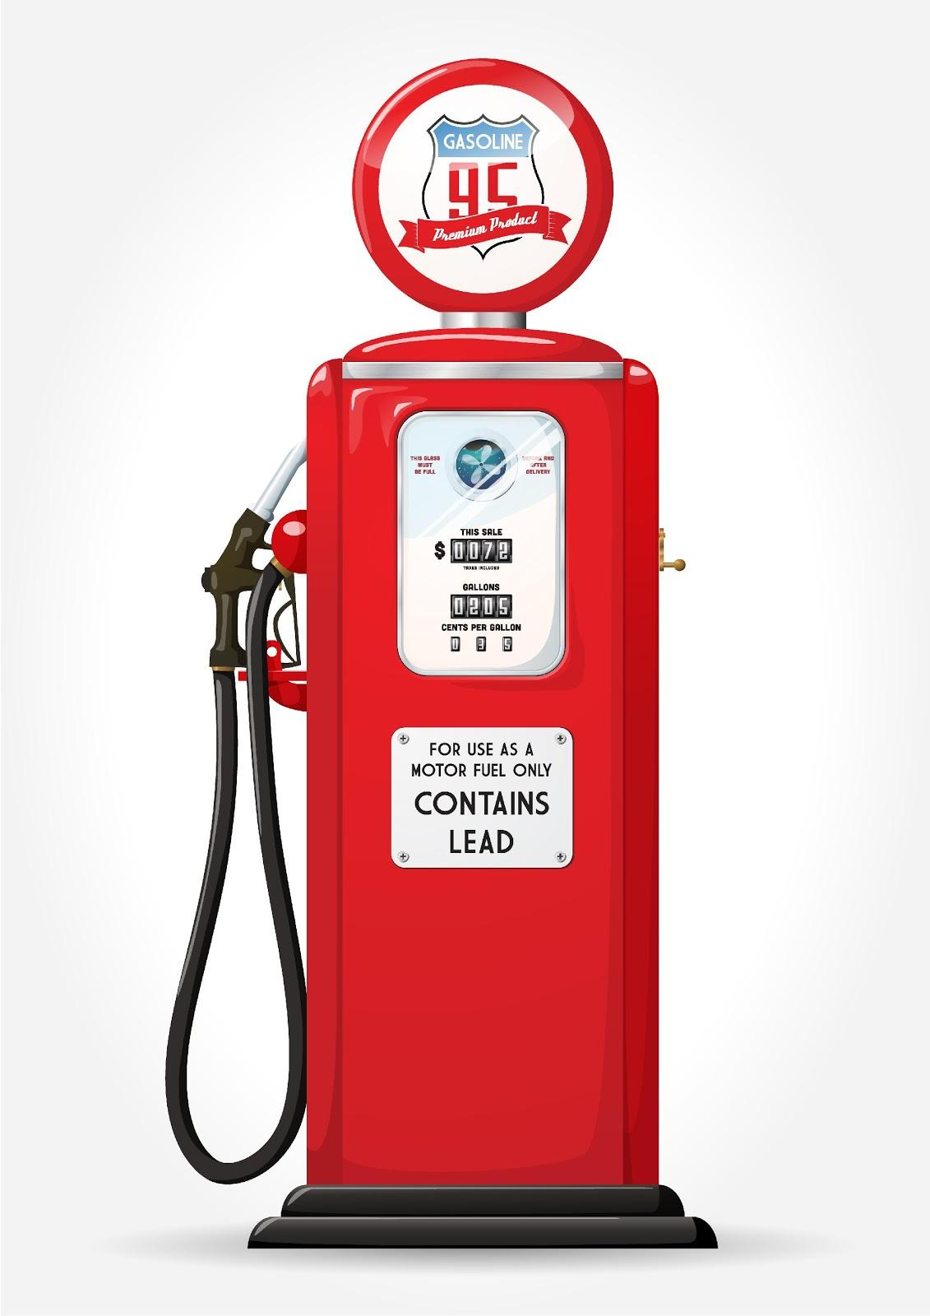
Review Lesson #1
In Lesson #1: We learned that our body is like a car. Our bodies must use a combination of 3 different types of fuels:
Protein=GROW foods Fats=Brain foods Carbohydrates=GO

Slide 3
Fuel
What would happen if you were to use a fuel that is not meant for your body?
Answer: Your car might not start or it could break down because it wouldn’t recognize that type of fuel.

Slide 4
Activity: High-quality fuels vs. Low-quality fuels
Bring two volunteers to the front of the room.
First volunteer will act like a race car performing at top speed with high-quality fuel.
The second volunteer will act like a race car performing at a slow, sluggish speed because of low-quality fuel.
Pretend to be race cars and show us how to perform based on the quality fuel in your tank.
2nd car
1s car

Slide 5
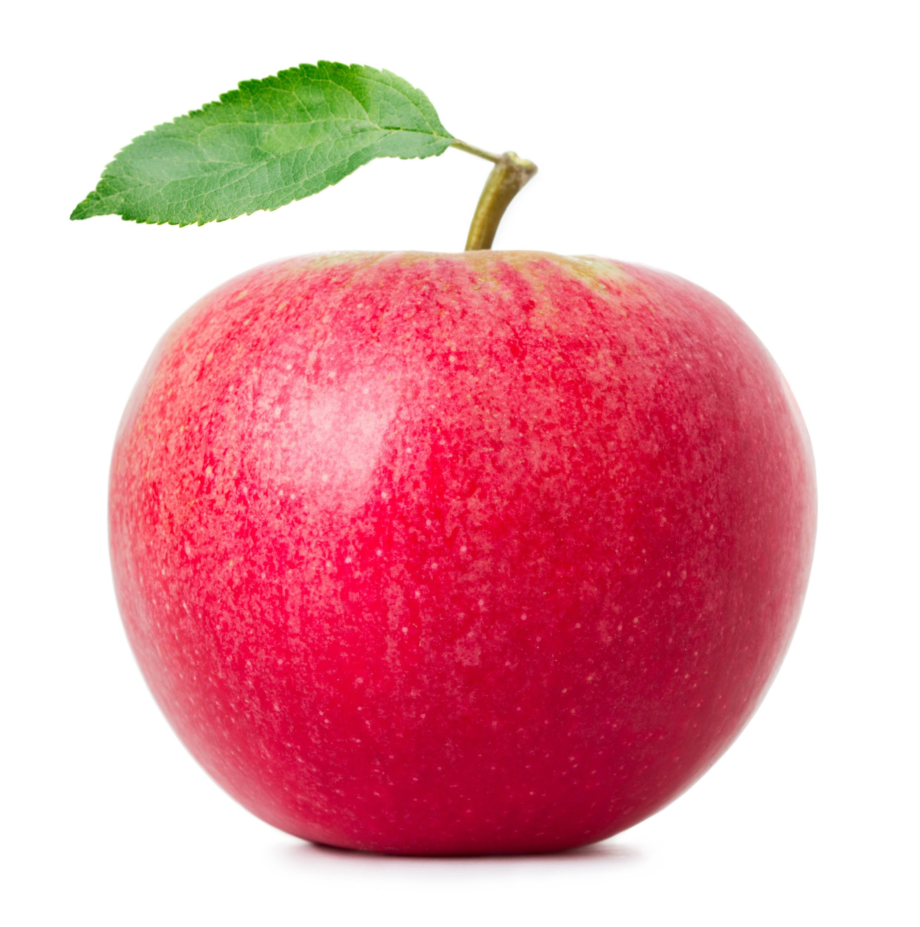
High Quality Fuel
1. Foods that are higher in quality are closest to their source. They look like when they did when they came from the farm or from nature.
Ex: Apple looks just like it did when it came from its source, the apple tree.
2. Higher-quality foods are either not processed at all or just minimally processed.
higher quality = closest to the source,
minimally processed

Slide 6
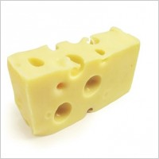
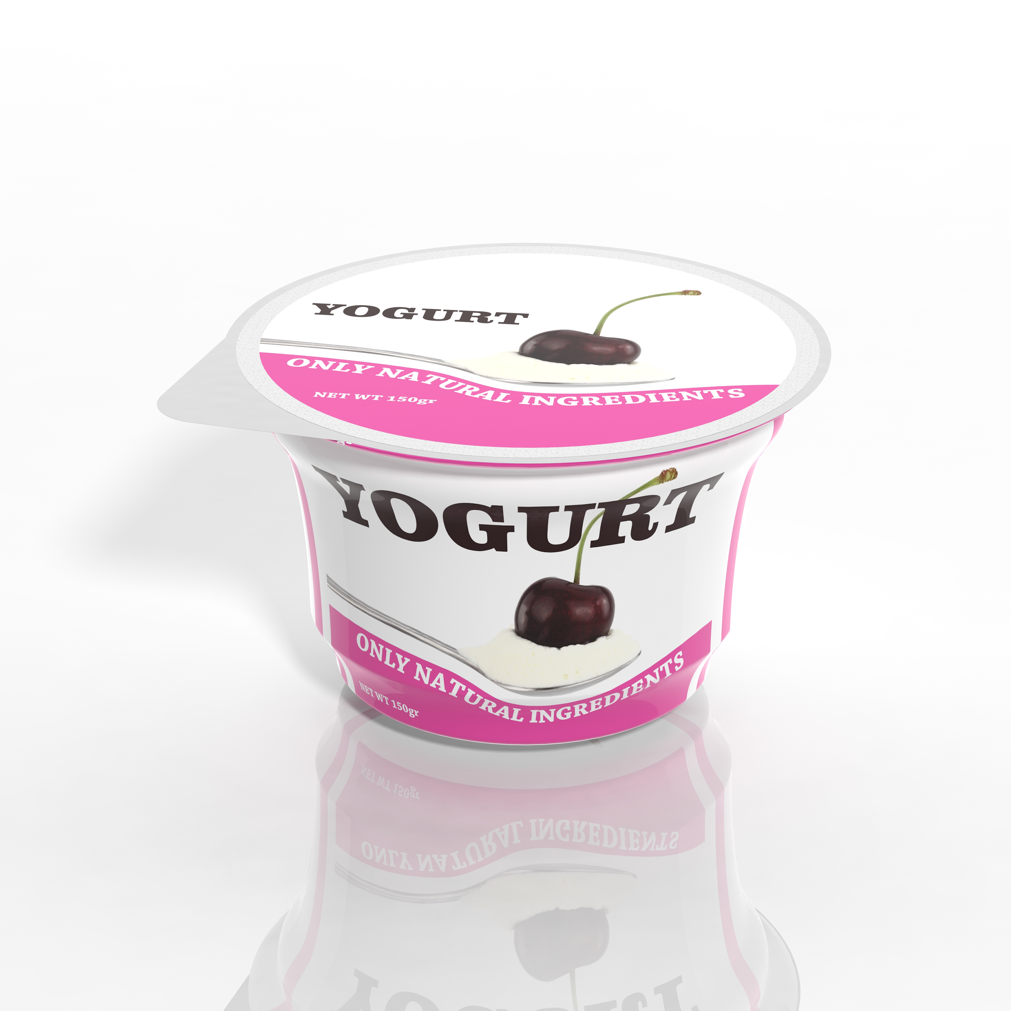
Low-Quality Fuel
When a food is processed, the way it looks, feels and tastes is changed. USUALLY, when a food is processed, something is taken away.
Processed = changed, usually something is taken away

Slide 7
Activity: High Quality Fuel to Low Quality Fuel
Pick 4 volunteers show how a high quality food can be processed, or changed, and made into a lower-quality food.
PROP: Props to be used are the apple, apple juice, applesauce, Apple Os.
Have 4 volunteers in the front of the room.
Give each volunteer a food prop in random order.
Hand each volunteer a food that is made from apples or CLAIMS to be made from apples.
Have the volunteers put in order from whole and closest to the source to farthest from the source meaning in, meaning it has been processed
Correct order; apple, apple sauce, apple juice, Apple Os.

Slide 8
3 Reasons: Choose foods closest to the source and minimally processed
Minimally processed foods, retain their original nutritional value.
We need the original nutrients found in foods because that is what feeds our cells.
When we feed our cells proper nutrients our bodies stay healthier because our immune system stays strong.

Slide 9
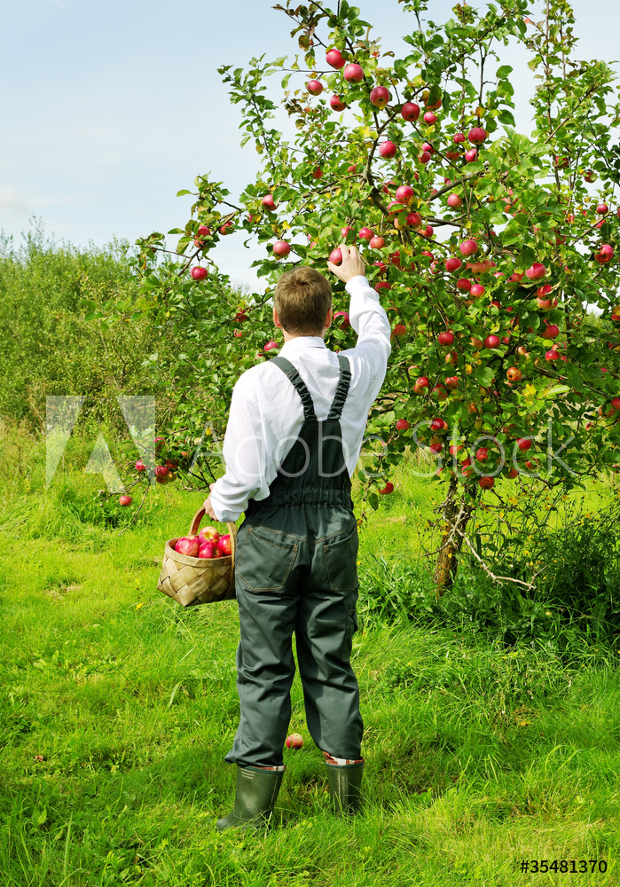
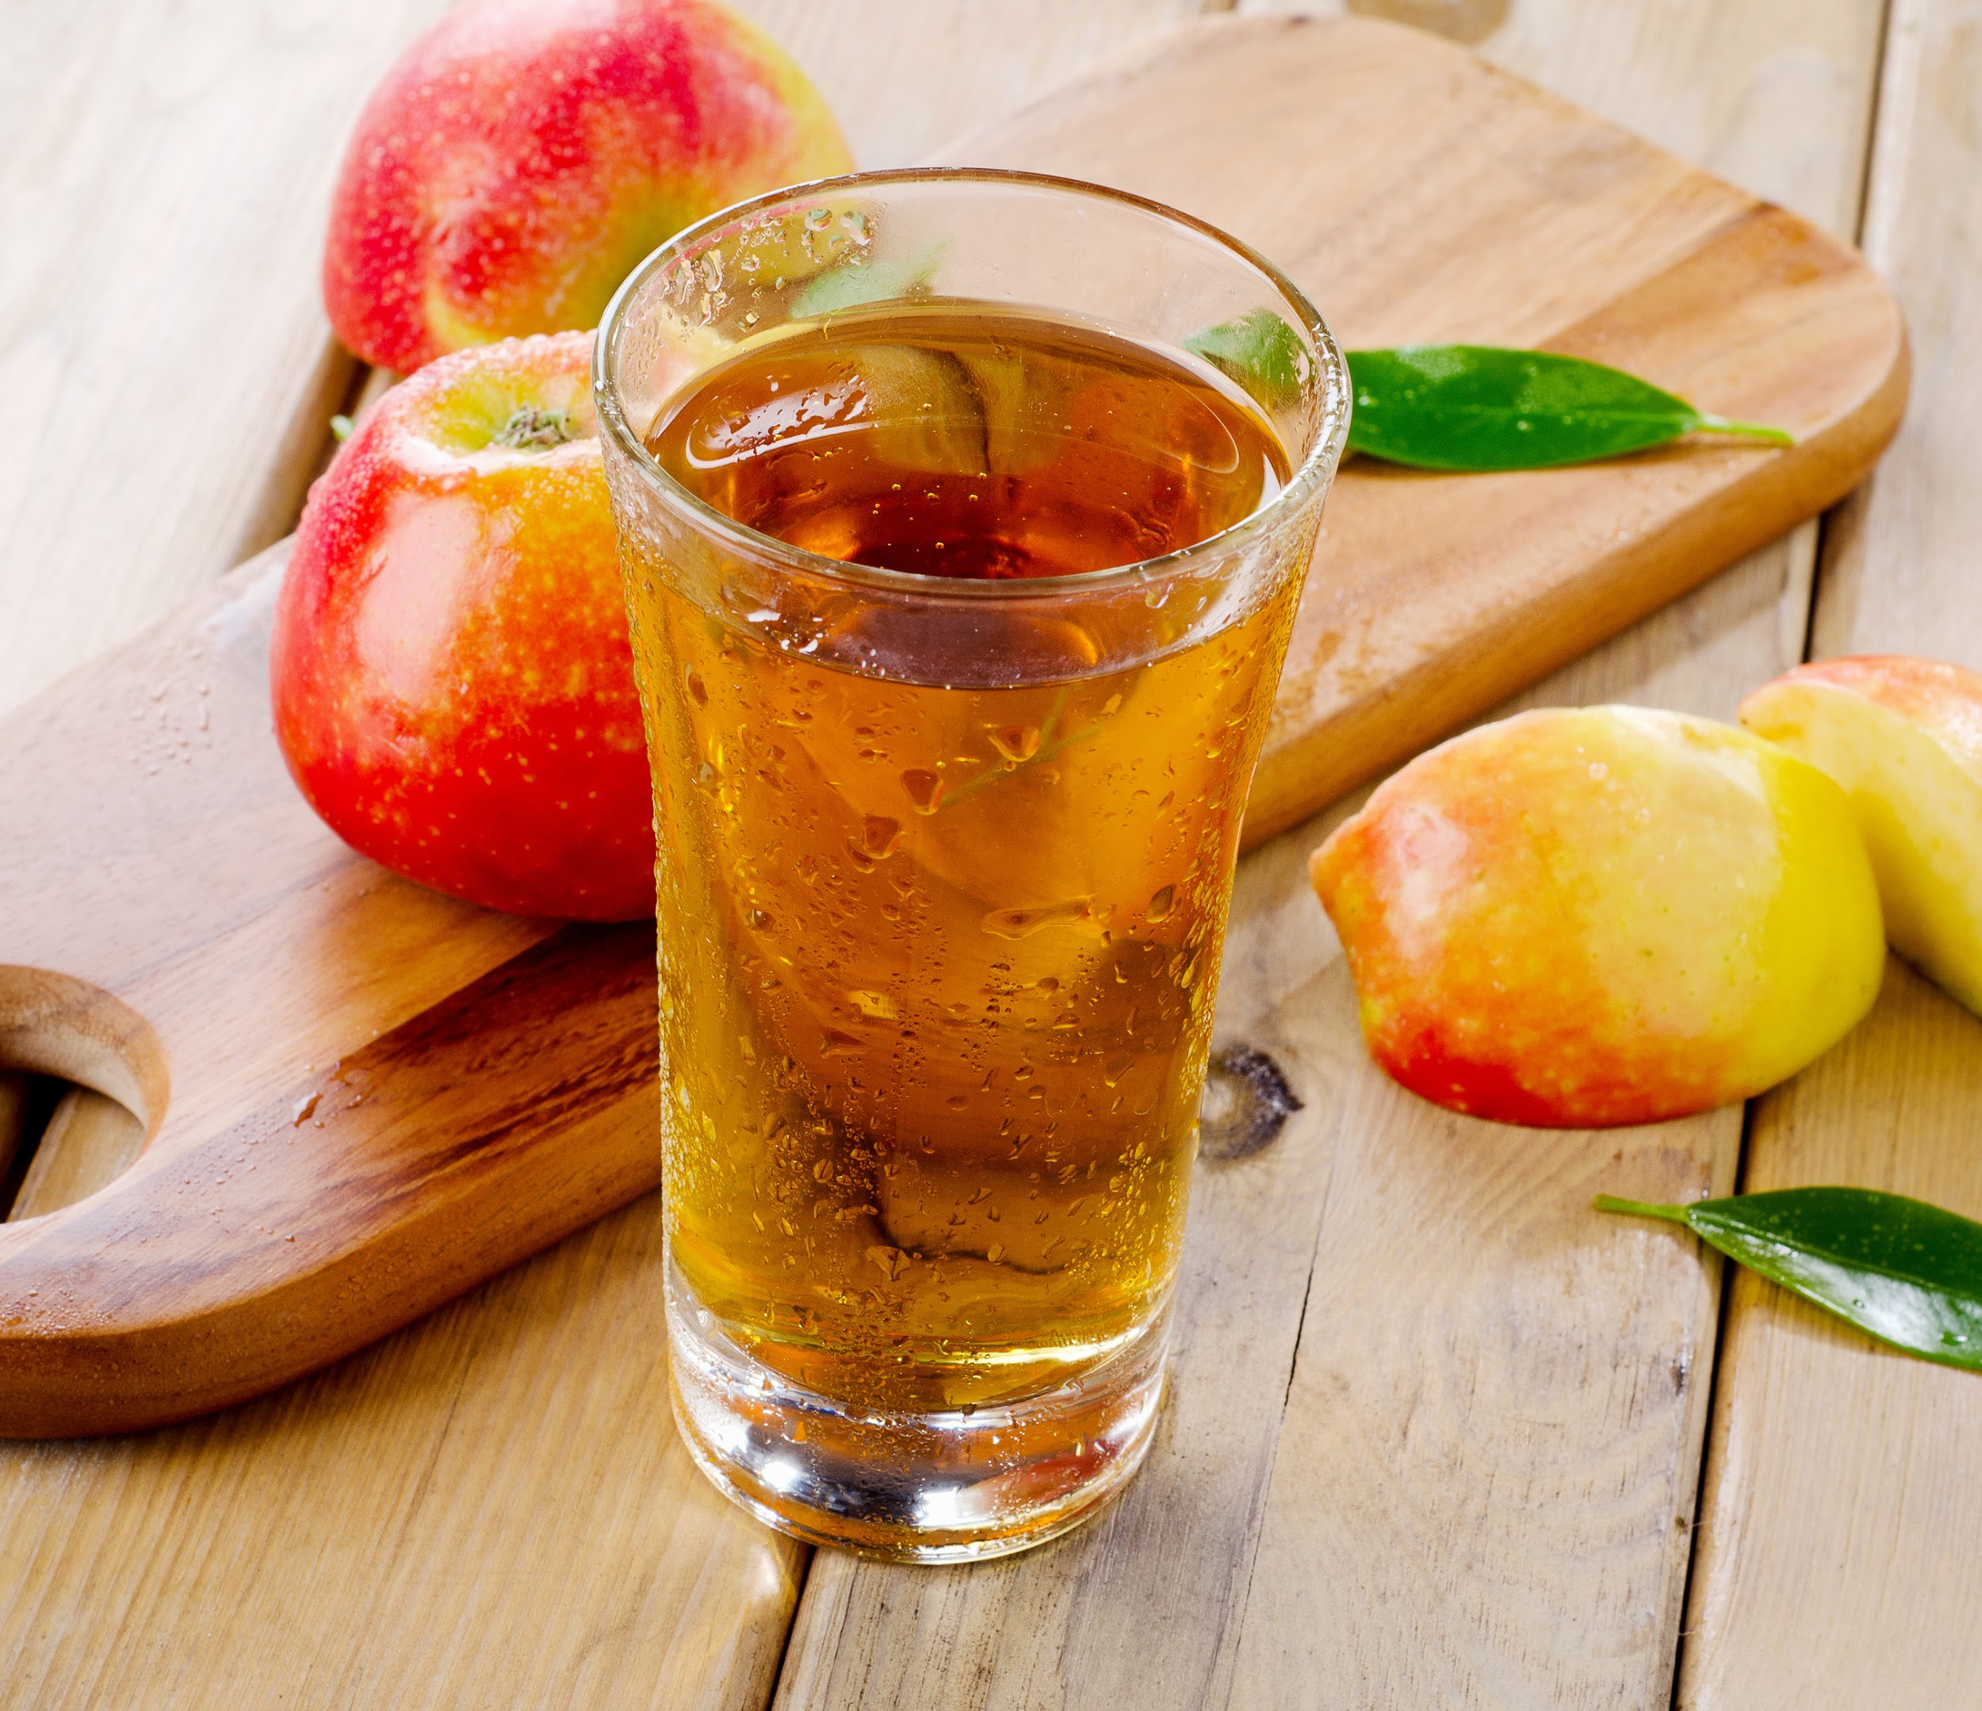
Characteristics of high-quality foods:
WHOLE, CLOSEST TO THE SOURCE, AND MINIMALLY PROCESSED. Ex: Apple

Slide 10
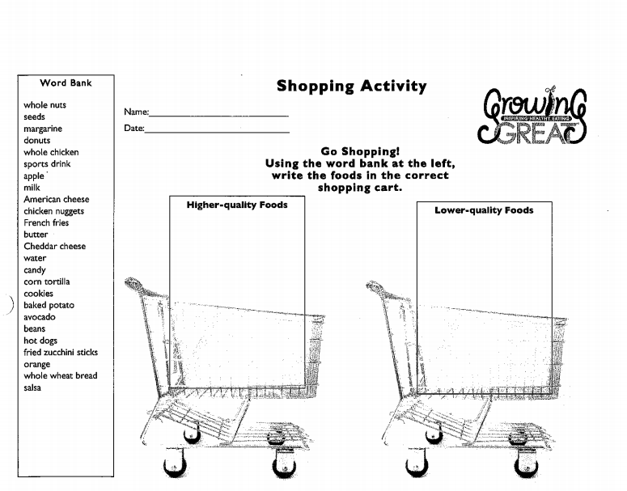
Activity: Let’s Go Shopping!

Slide 11
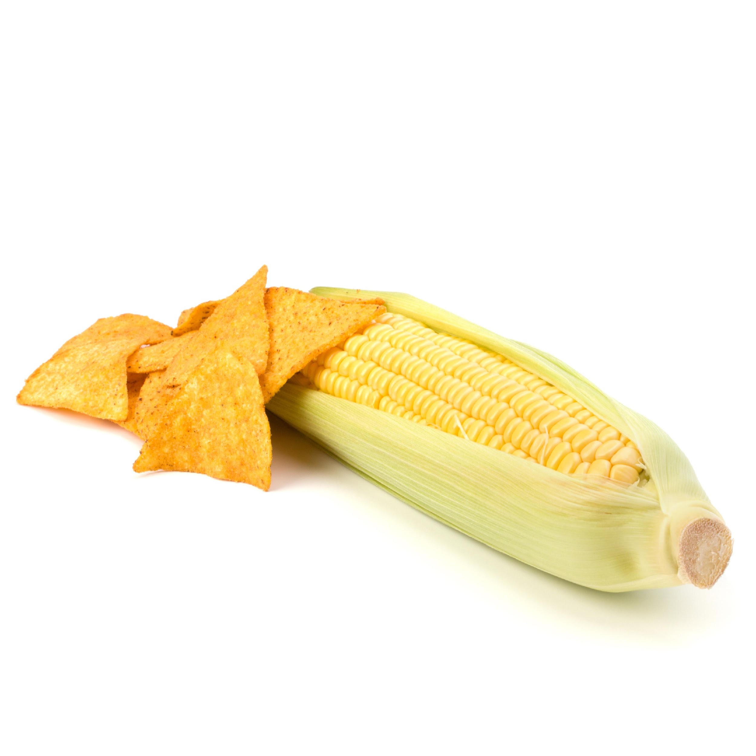
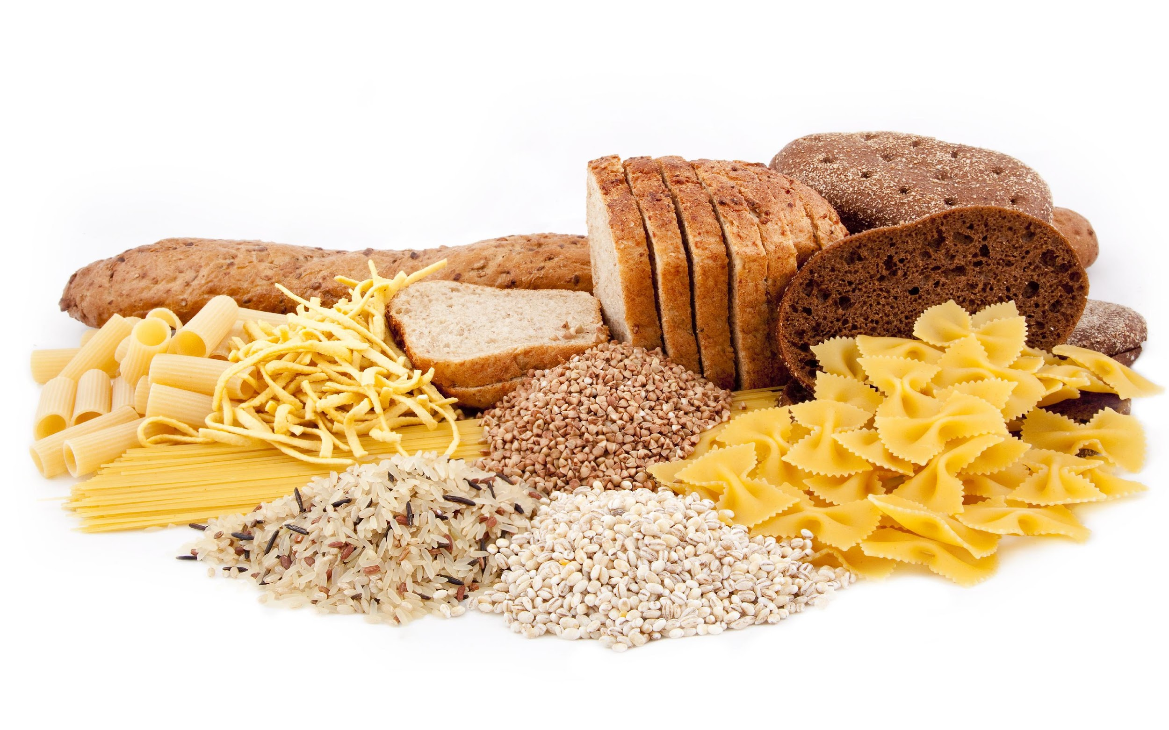
Higher-quality foods are…
What are some higher-quality foods that are whole and close to their source and minimally processed and what they might be processed into?
Examples:
Corn=corn chips
Fig=Fig Newton
Chicken breast=chicken nuggets
Whole wheat bread=white bread
Fruit=fruit leather
Fruit=fruit juice

Slide 12
2 ways to spot higher-quality food?
1. Whole, closest to the source
2. Minimally processed

Slide 13
Review
Whole food, close to its original source is a “high-quality” food such as an apple.
Processed foods are “low-quality” foods such as applesauce.
High-quality foods are:
Whole, closest to their original source or from nature
Minimally processed

Slide 14
