Slide 1

Lesson #5
Kids and Advertising

Slide 2
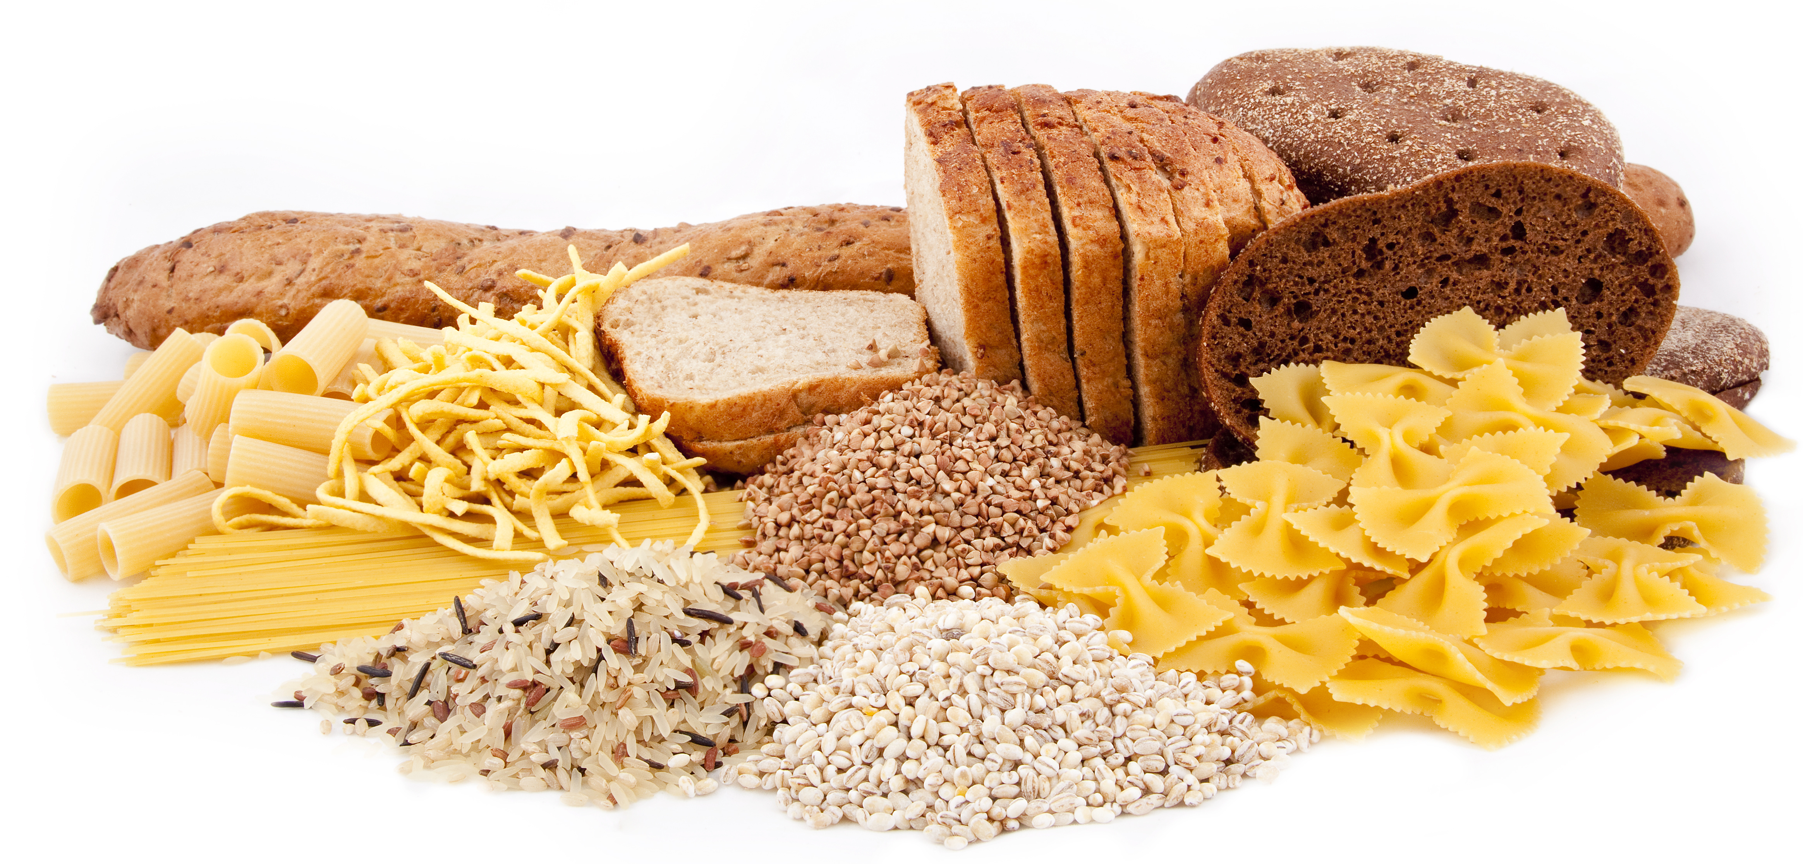
Review: Whole Grains
What is an example of a whole grain?
What are some common types of grains?
Which fuel type(s) are grains?
Grain that is ground up into powder is called______.
Processed = changed from its original source
Notes:
Rev

Slide 3
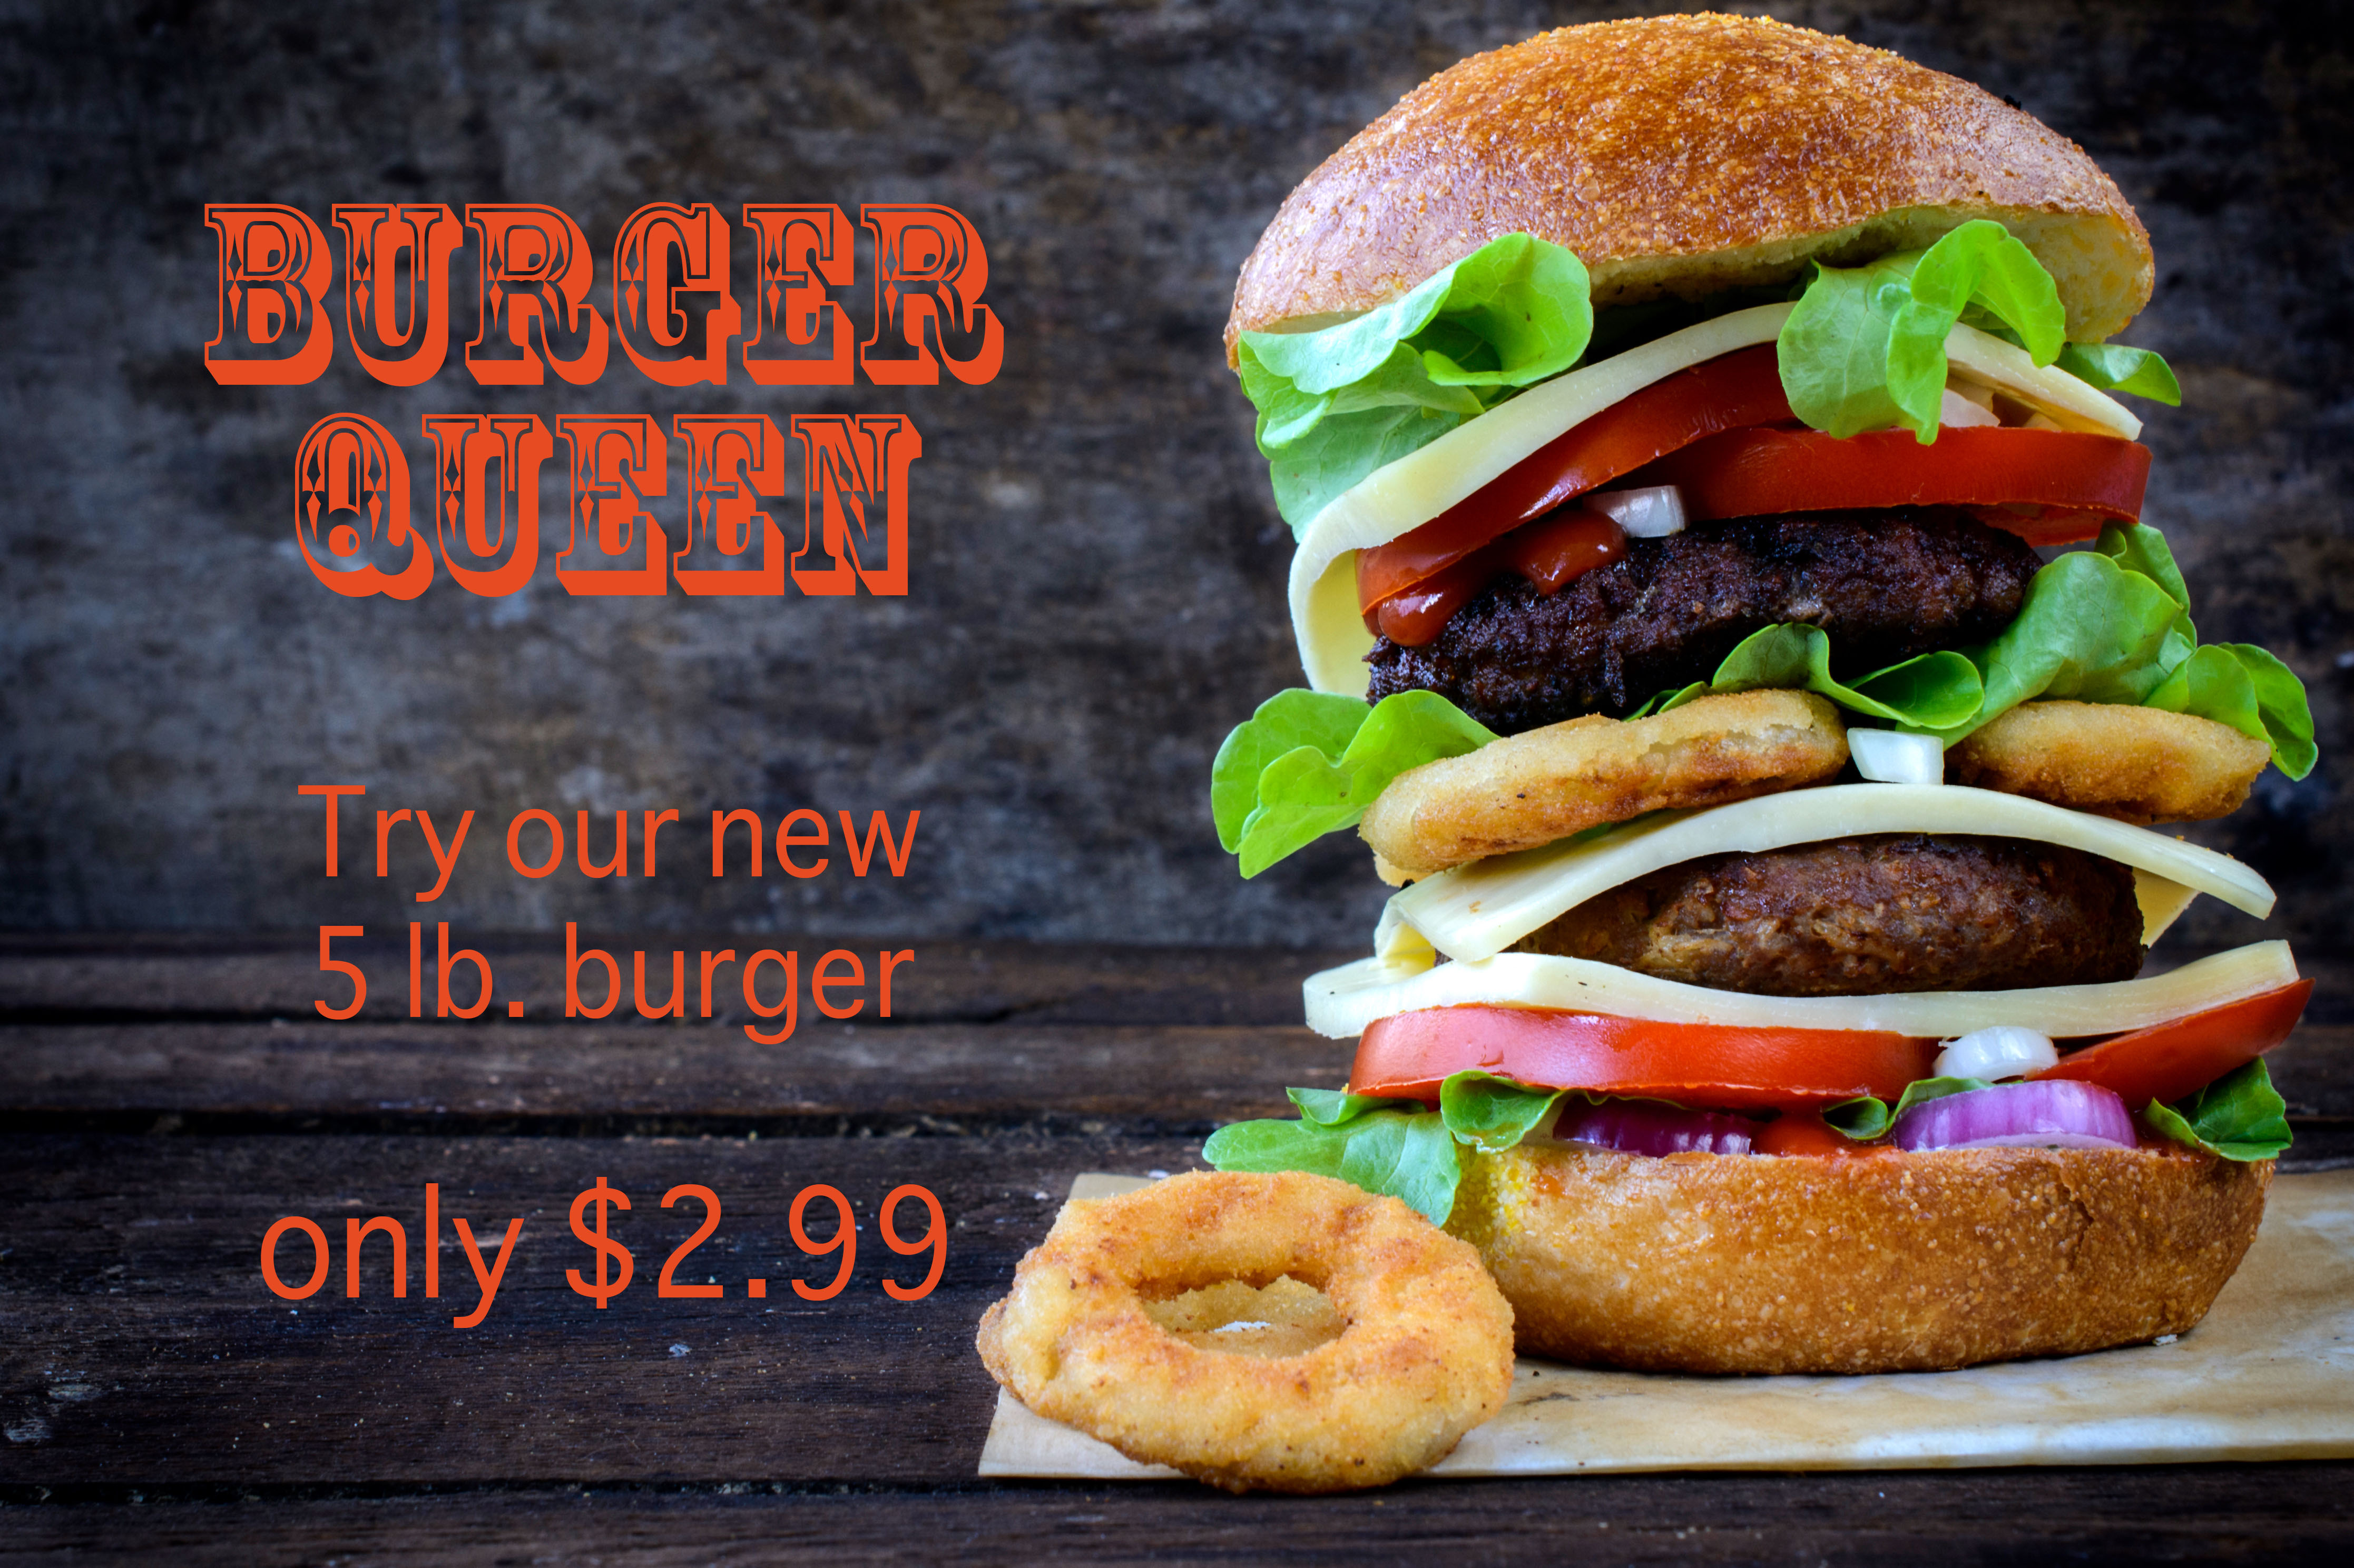
Advertising
Companies use advertising to get people to buy different products such as:
Food
Toys
Games
Movies

Slide 4
Where is Advertising?
Print ads in magazines and newspapers
Internet ads on various websites
TV commercials
Radio
Billboards
Cars/trucks

Slide 5

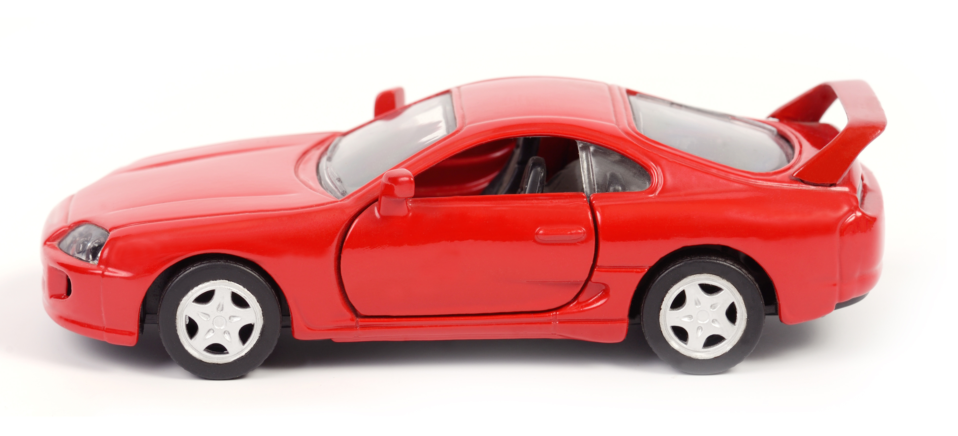
Getting Your Attention
Companies create advertisements that capture your attention so that you BUY their product. Different ways they do this:
Gimmicks: clubs, prizes, games
Give-Aways: toys in cereal boxes or in fast food meals
Music, songs or jingles
Famous people (athletes, celebrities)
Catch Tag Lines: “Silly Rabbit! _______ are for kids.”

Slide 6
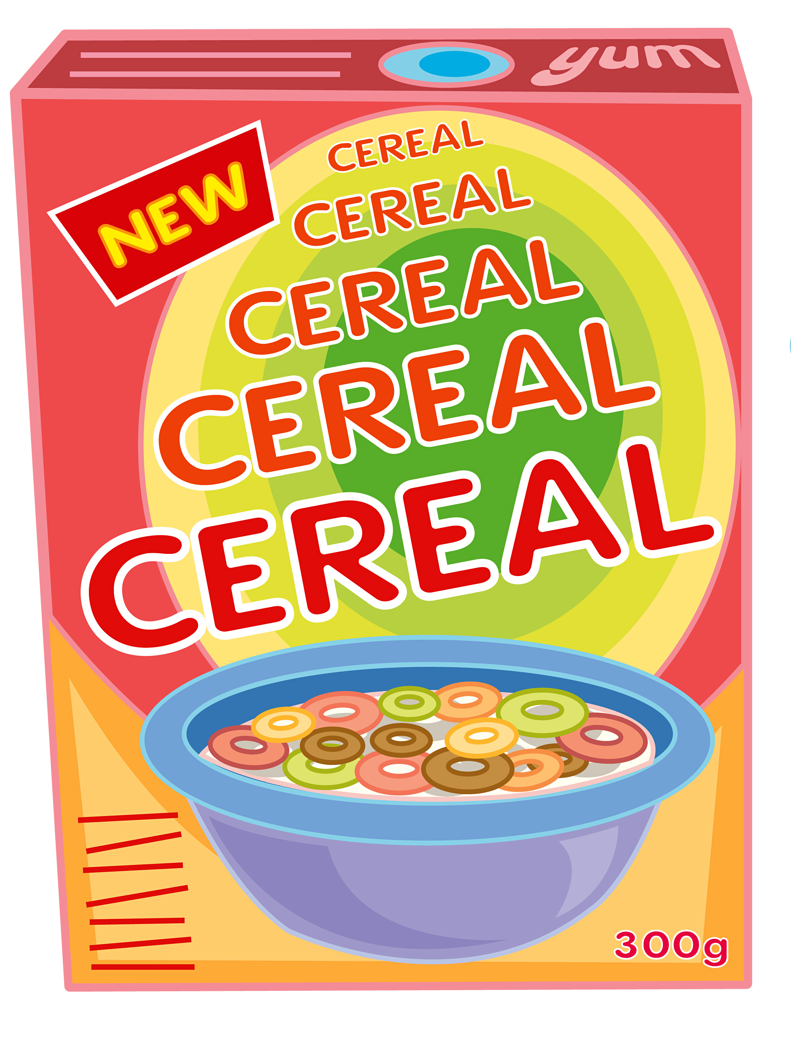
Cereal Advertising
The average adult’s cereal is placed twice as high as the children’s cereal.
Adult cereal characters look adults straight in the eye.
Children’s cereal characters look down at them.
Next time you are at the market take a look at the cereal boxes!

Slide 7

How They Capture Your Interest
Characters created with bright colors
- Tony the Tiger
- Toucan Sam
- Nestle Quick Bunny

Slide 8
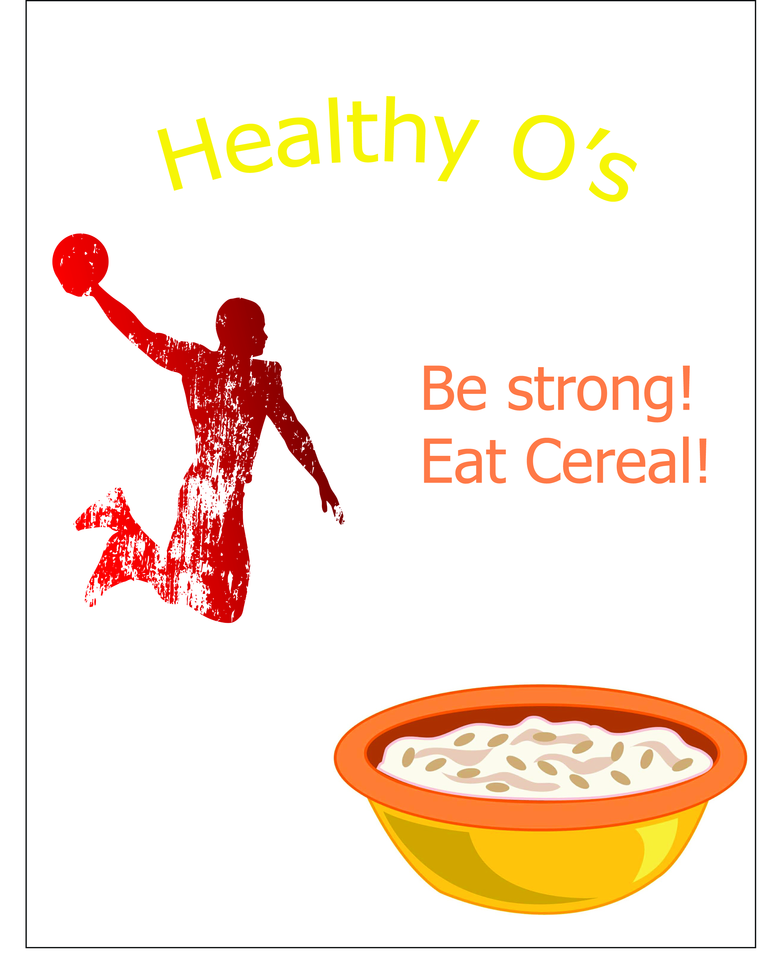
Claims That Stretch the Truth
“Part of a nutritious breakfast”
Suggesting you will be a better athlete or have more energy if you drink their sports drinks
*These strategies used by advertisers work!

Slide 9
Food & Advertising
Have you ever asked your parents to buy a certain food after seeing it on TV?
Advertisements for food are the most common ads we see daily.
A lot of money is spent on trying to sell low-quality foods to kids like you.
Can you name a highly-processed food that is lower in quality and advertised in commercials?

Slide 10
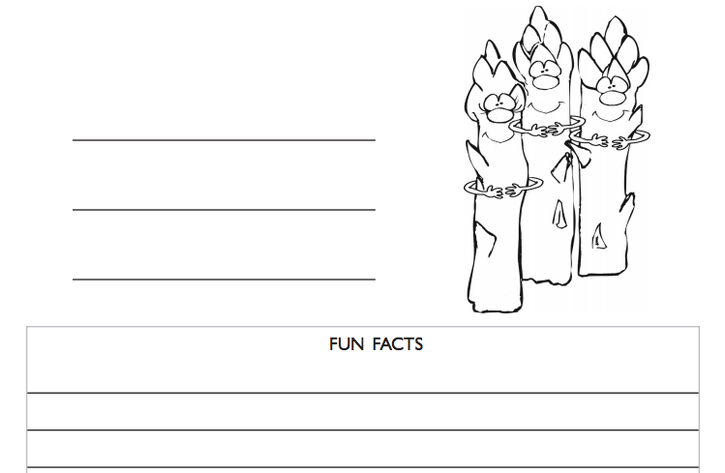
Activity

Slide 11





