Slide 1
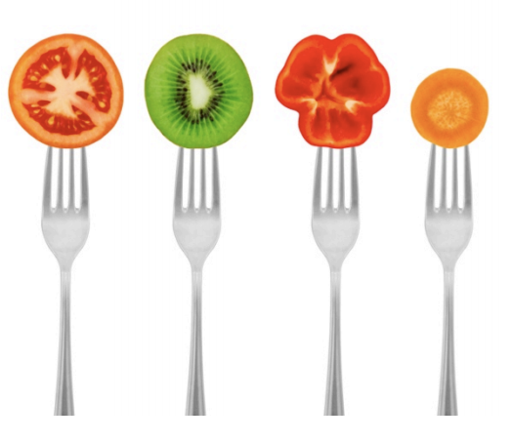
GrowingGreat Snack Suggestions
3rd-5th Grades/Volume 1
kkkk
Let’s eat!
For your reference, we have provided suggestions for food samples “tastes” to serve following each lesson. These are just suggestions. Please avoid food waste. Note any allergies.
Lesson 1
Feed Your Engine: Proteins, Fats, and Carbohydrates
Lesson 3
Food Investigator
Lesson 4
Start Your Engines w/High Quality Breakfast
Lesson 2
Feeding Your Engines w/High Quality Foods
Lesson 4
Warning Lights
“Let food be thy medicine, and medicine be thy food.” - Hippocrates

Slide 2
Our Mission
GrowingGreat’s mission is to build nourishing, learning communities that empower children to make healthy food choices.

Slide 3
Remember . . . before you serve any food at school in a classroom.
Check your school’s food handling guidelines. Some schools require you to prepare all food samples onsite.
Allergies - Get a list of student allergies from your teacher. We have avoided giving snack suggestions with nuts, but some of our suggestions contain other common allergens.
If you are serving something perishable, make sure food is stored in an on-site refrigerator (staff lounge, PTA room, classroom) or transport the food to school in a cooler with ice.
Always wear gloves when preparing and distributing food.
Long hair should be tied back while preparing food.
Always offer the teacher, parent volunteer or teacher assistant a food sample.
If serving food samples, shop wisely and don’t over purchase food.
Food samples are intended to be a “taste” with the goal that students will go home and inform their family to try!

Slide 4
Lesson 1. Fuel Your Engine: Proteins, Fats, and Carbohydrates (PFC’s)
Students learn that proteins, fats and carbohydrates (PFC’s) are the nutrients that fuel a human body. Go, Grow and Brain Health! We suggest you choose one of these 3 simple samples.
Breakfast Wrap
P & F:Sunflower Seed Butter
C: Sliced Banana
C:Whole Wheat Tortilla
Helpful Hint: 1 Jar, 2 large bananas, and 1 package of wheat tortilla per class. Cut tortilla in quarters.
PFC Stack
P: Sunflower Seeds
F: Smashed Avocado
C: Sliced Cucumber or Dried Veggie Chip
GrowingGreat PFC Wrap
P: Sliced turkey or ham
F: Any flavored hummus
C: Romaine lettuce or butter lettuce
GrowingGreat PFC Wrap Tip: One Romaine lettuce leaf, one-half slice meat, and one-half slice cheese will feed 2 students.

Slide 5
Lesson 2. Feeding Your Engines w/HQF
Students are guided through an interactive lesson designed to teach them how to identify higher-quality foods that are minimally processed. Close to the source means something that is close to “nature”.
Rainbow carrots with beet hummus or any flavored hummus.
Helpful Tip: Purple, White, and Yellow carrots are fun to eat!
Sliced Seasonal Pears or Apples.
Bean Dip with carrot sticks or veggie chip
Any dried fruit or veggies
Helpful Tip: Look in produce area of market and find dried green bean snacks!
“If you look the right way, you can see that the whole world is a garden.” -- Anonymous

Slide 6
Lesson 3. Food Investigator
Students learn how to analyze the Nutrition Facts Label and Ingredient lists to identify higher-quality foods.
Whole grain toast with all-fruit spread, seed butter (optional: real butter)
Whole grain toast topped with avocado, cucumber or radish.
Helpful Tip: Try putting some micro-greens or everything bagel seasoning!
Baked corn chip with salsa.
Helpful Tip: Get creative with salsa. Serve mango salsa!
Visit your community Farmers Market to find many of the suggested food samples.

Slide 7
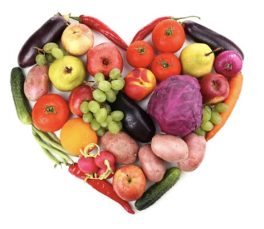
Lesson 4. Start Your Engine w/High Quality Breakfast
This lesson teaches students why breakfast is important and how to identify higher-quality foods that, when eaten at breakfast, help them perform at their best.
Plain, whole yogurt with fresh seasonal blueberries.
Whole-grain cereal, low in sugar
Overnight Oats with almond milk and strawberries.
Whole grain toast with sunbutter spread
Helpful Tip: Be creative with HQ spreads, butters, or avocado
“Eat less from a box and more from the Earth” - Food Matters

Slide 8
Lesson 5. Heed Your Warning Lights!
In this lesson, students learn the importance of listening to their bodies’ signals and about food allergies and sensitivities..
Fresh spinach with homemade dressing
Gluten-free products – pretzels, crackers, bread, etc.
Seasonal fruit or vegetable, cut up into bite-sized pieces
WHOLE, close to the source, & minimally processed foods are best!

