Slide 1
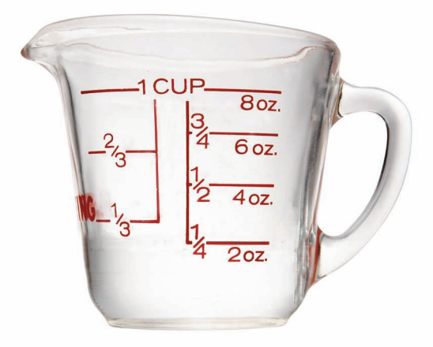
Lesson #3
What Is A Serving Size?
Farm To Table

Slide 2
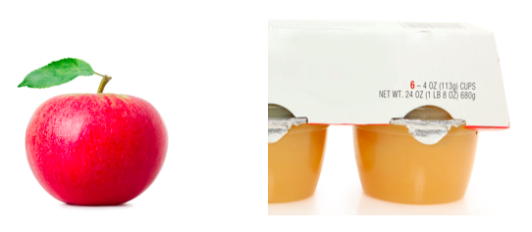
Review Lesson #2

Slide 3
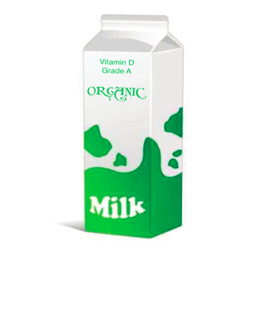
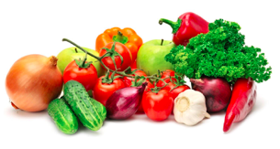
FILL UP
What is a Serving Size?
Today we are going to discuss HOW MUCH of our foods we need to eat to get all their nutrients.
Remember the high-quality foods we learned about in Lesson #2!

Slide 4
ACTIVITY
Today we are going to work together on an activity.
After I introduce each food on the activity sheet please CIRCLE the amount that you would normally be served (not eat).
We will put aside the activity sheet when we have completed it.

Slide 5
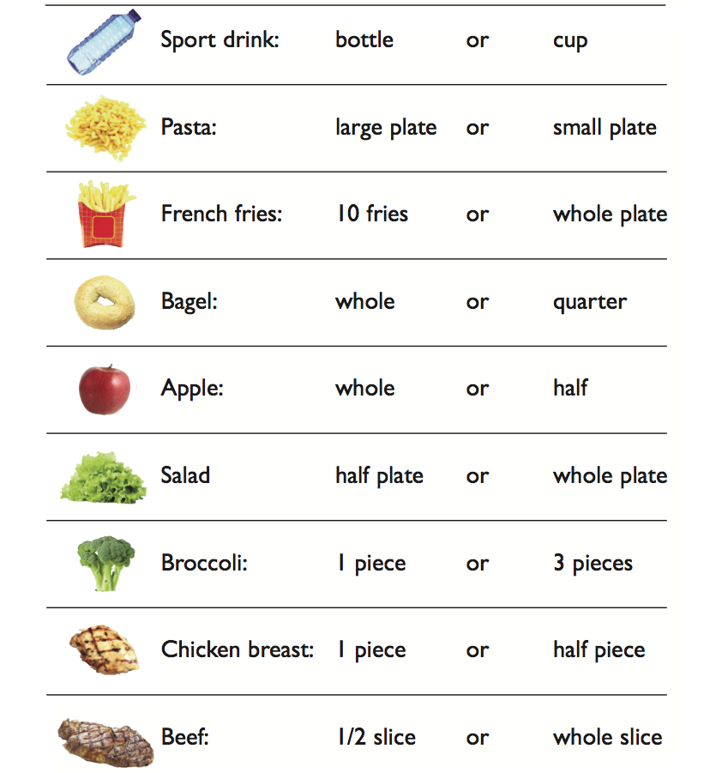

Slide 6
Question?
Fresh roasted chicken is a high-quality food which is whole and close to the source.
PROTEIN: helps our muscles grow, keeps our immune system strong to stay well, and keeps us satisfied longer so we can concentrate
QUESTION?
Do you think eating an ENTIRE chicken would be good or beneficial for our body?

Slide 7
ANSWER
Think about the signs your body would give you if you sat down and gobbled up an entire cooked chicken?
-Gas
-Full
-Bloated
-Tired
If you eat TOO much of a food your body has a hard time digesting.

Slide 8
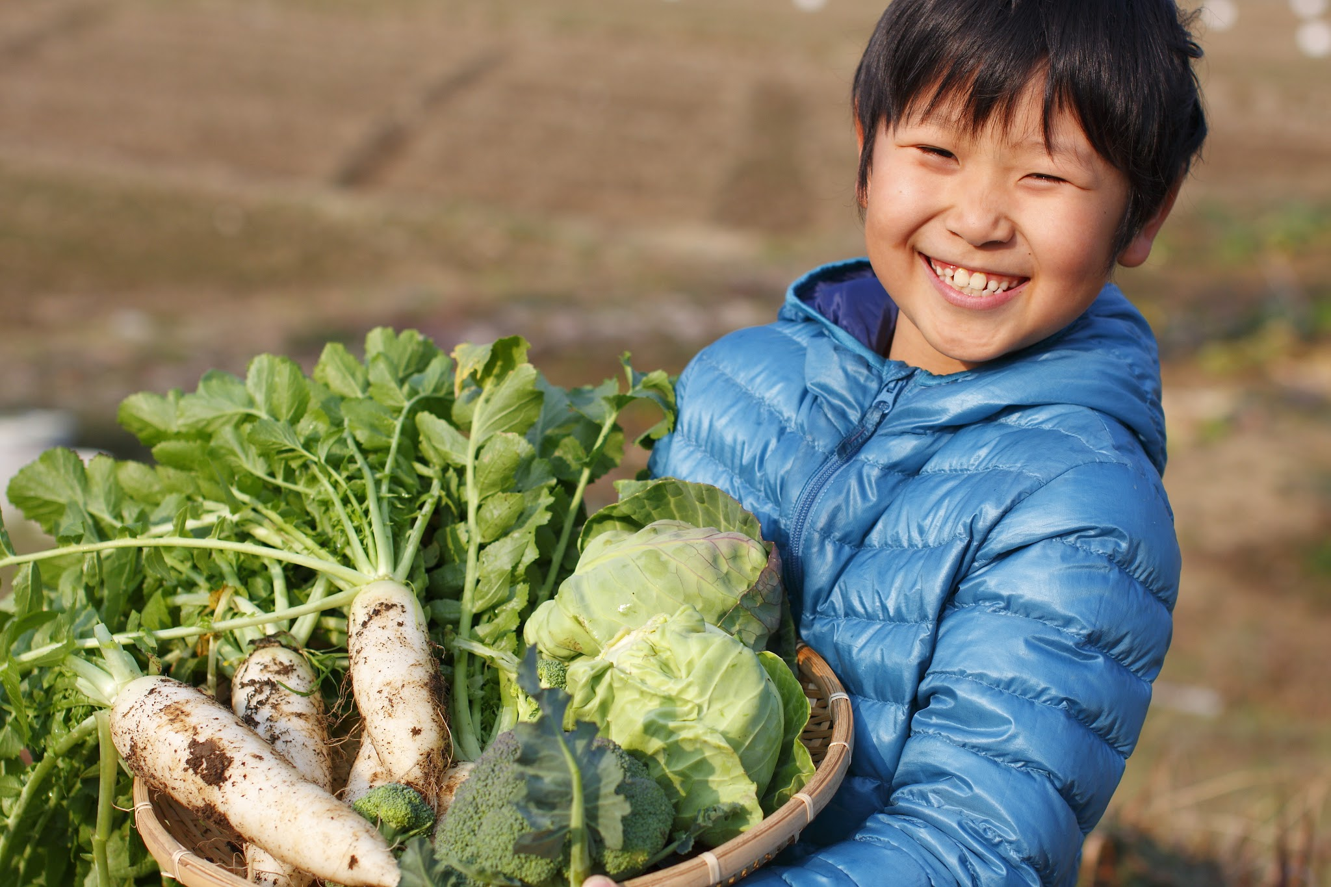
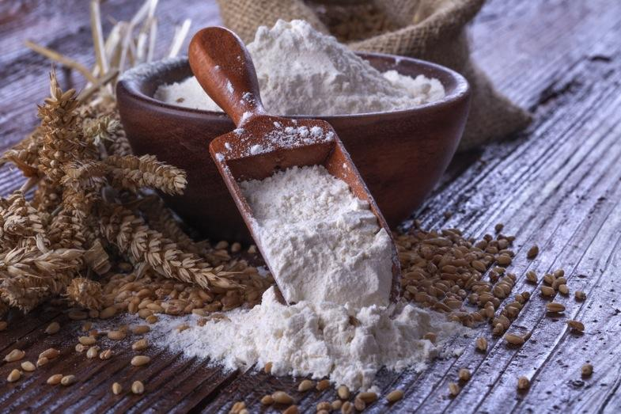
The RIGHT Amount
The key IS to choose the RIGHT amount of food for you and your body , so you feel satisfied and you have room to eat other important foods such as vegetable and whole grains.

Slide 9
Serving Size?
What does this mean?
A serving size is a measured amount of food. For example:
8 ounces of juice, 2 small cookies, 2 tablespoons of peanut butter . . .
SERVING SIZE = a measured amount of food, usually the suggested amount you should eat.

Slide 10
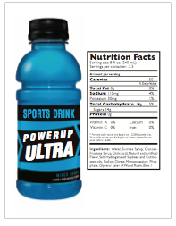
Let’s Investigate!
What does a serving size look like?
Read the NUTRITION FACTS
label and what does the
label say is the serving
size? How many servings
does it have?

Slide 11
Sport Drink
Let’s look back at our activity sheet and see the difference between a recommended serving size and the amount that is typically served.

Slide 12
Sport Drink: Serving Size?
Look at the activity sheet: What did you circle on the activity sheet? Bottle or Cup?
Hint: The serving size states “a cup”.

Slide 13
Following the Serving Size
Why is it important?
Each serving contains a certain amount of added ingredients such as sugar, artificial colors, and flavors.
Too many servings of a sugary drink such as a sports drink or soda may cause you to feel cranky, tired, or you can get cavities.

Slide 14
Pasta!
Let’s look back at the activity sheet and see what you chose for the portion served.

Slide 15
Pasta: Large or Small?
What do you chose for the portion?
*When you go out to eat you are usually served a huge plate of pasta with some type of sauce. Usually you can’t finish your plate!

Slide 16
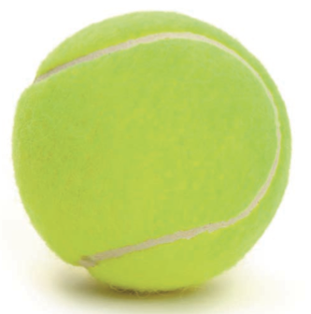
Pasta: Read Ingredient Label
If you read a package of spaghetti, it tells you that a serving size of cooked pasta is half a cup.
This is an amount equal to about the size of half a tennis ball.

Slide 17
Serving Size: Healthy Facts
Choose a smaller serving of pasta and leave room for other high-quality foods from different fuel types such as fruit and vegetable carbohydrates.
Instead of loading up on a lot of the same type of foods add other high-quality foods for a balance of different nutrients.

Slide 18
Colorful Meals
Choose colorful food that are whole and close to the source!
Share your portion at dinner with family.
Add vegetables and fruit to meal.
Choose Colorful foods with different nutrients which will benefit your body.

Slide 19
Serving Size: No Ingredient Label!
How can we identify a serving size when there is no package with an ingredient label?
We can “estimate” the serving size.
Question: Who circled “10 fries” on their activity sheet?

Slide 20
French Fries
A serving size of french fries is recommended at about 10 fries!
It is important to minimize the amount of fries because they are deep-fried in harmful oil.
A great idea is to order a half order or share!
Ordering fruit or salad is a colorful alternative.

Slide 21
Serving Size: Snacks
Let’s look at the bag of corn chips and see is the bag is equal to 2 servings. 4 servings? 6 servings?
Hint: Read the # of servings contained in the bag

Slide 22
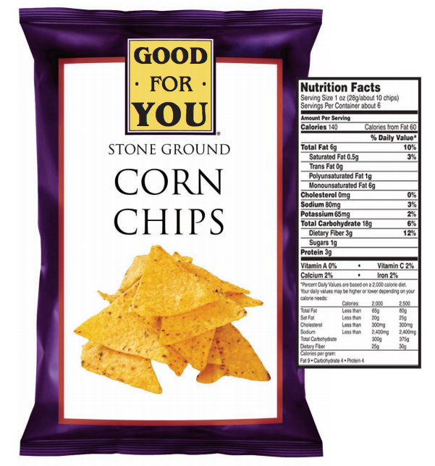

Slide 23
Whole Bagel
Let’s look back at the activity sheet and see what you chose for the portion size.

Slide 24
Whole Bagel: Serving Size?
How many circled the whole bagel?
We are usually served the WHOLE bagel which has approximately 4 servings in it! Bagels today are very large in size. A quarter is a the correct serving size!

Slide 25
Apple
Let’s look back at the activity sheet and see what you chose for portion size.

Slide 26
Apple: Serving Size?
One serving size of fruit is ONE whole apple!
Hint: A serving of fruit is equal to the size of a tennis ball!

Slide 27
Salad
Let’s look back at the activity sheet and see what you chose for the portion size.

Slide 28
Salad: Serving Size?
Half of plate or whole plate of salad?
Fact: One serving of salad is ONE CUP. We need 5 servings of fruits and vegetables per day. A whole plate of salad would be equal to almost 2 servings of veggies!

Slide 29
Broccoli, Chicken, and Beef
What did you circle on your activity sheet?

Slide 30
Broccoli, Chicken, Beef: Serving Size?
Broccoli = 3 pieces
Chicken breast = half piece
Beef = whole slice
Hint: One serving of meat or protein is equal to the palm of your hand.

Slide 31
Decorate Your Plate

Slide 32
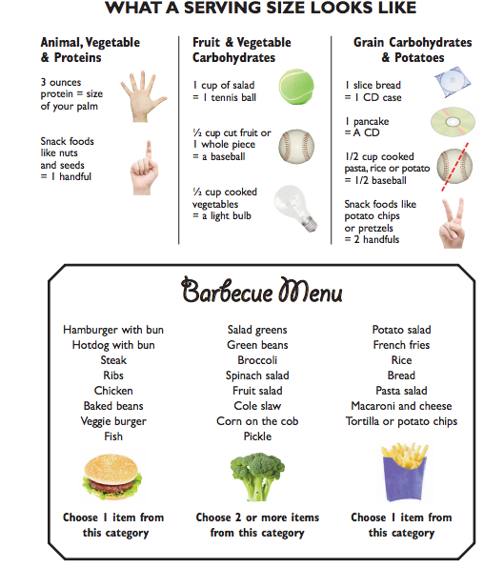

Slide 33
Review
Remember to use what you learned today with each meal.
It’s important to know the serving size of the foods we eat.
Eating too much food is hard for the body to digest, so erving size matters.
A serving size is the measured amount of food that is recommended.
A serving size of protein is approximately the size of the palm of your hand.
It’s best to choose a variety of colorful, whole foods, close ot the source, to make sure you are getting the NUTRIENTS you need every day.

Slide 34
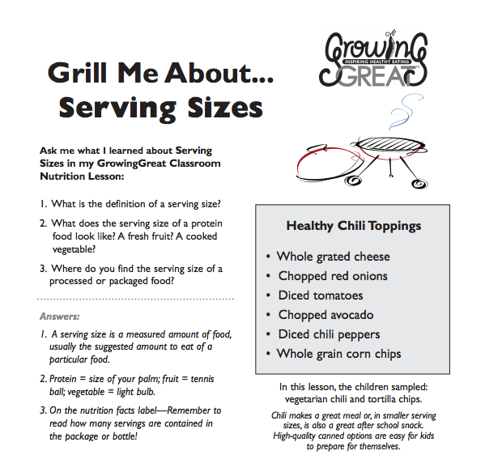
Grill Me About

Slide 35
Serving Size Estimate Chart

Slide 36
THANK YOU!

