Slide 1


Fiifiid
Lesson #3: Know What Is In Your Fuel?

Slide 2
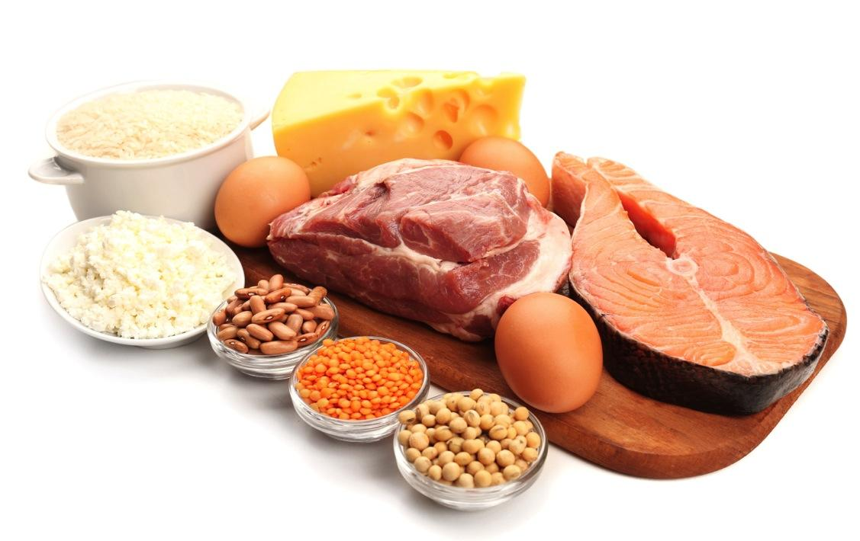
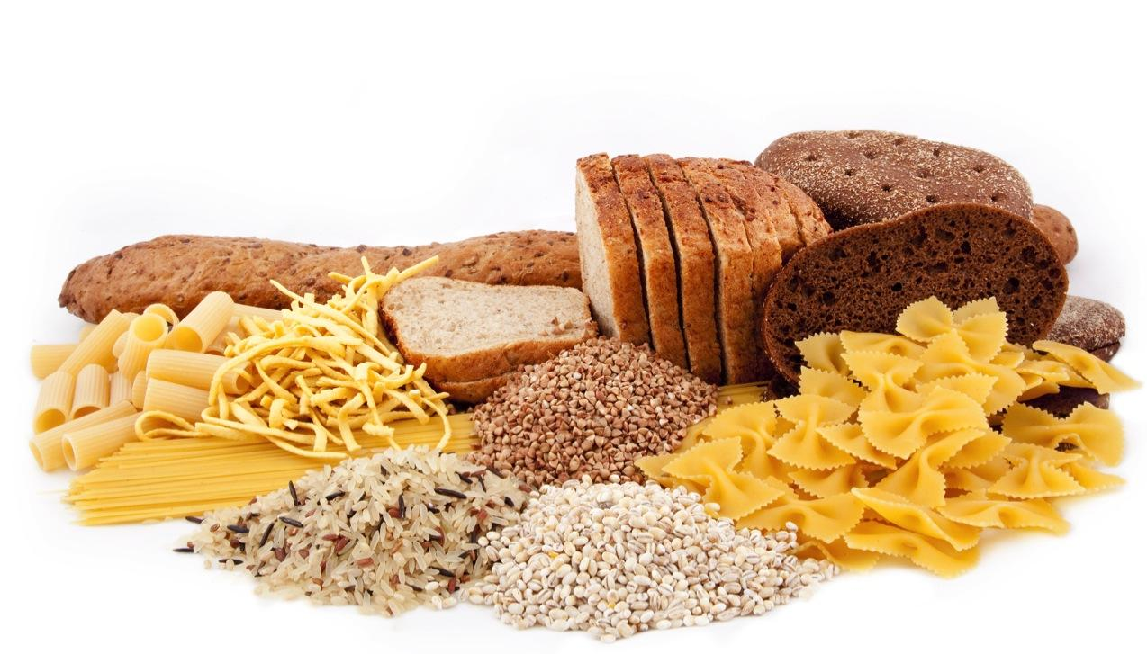
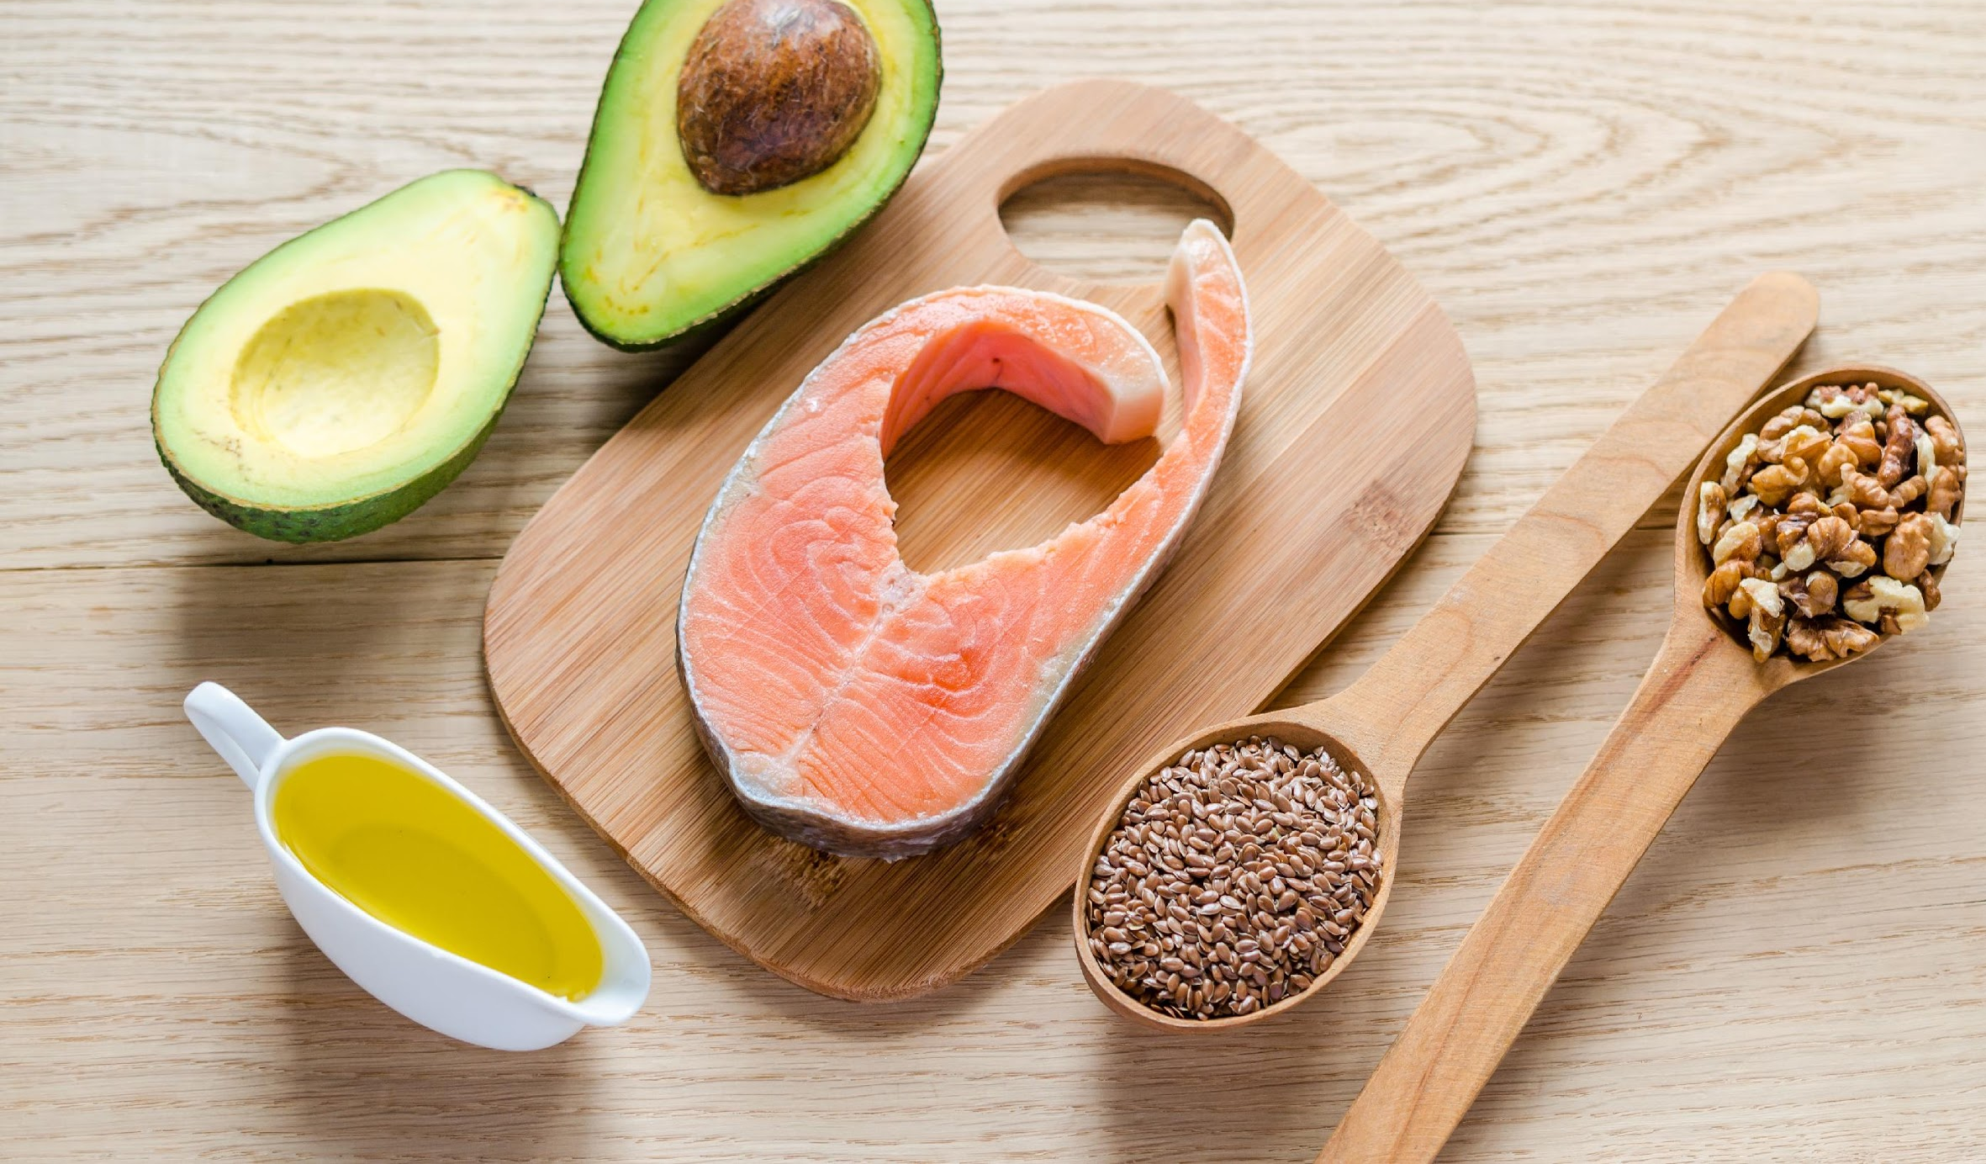


Let’s Review!
Feed Your Engines: PFC’s
What are the three fuel types that feed our body? HINT: PFC

Slide 3
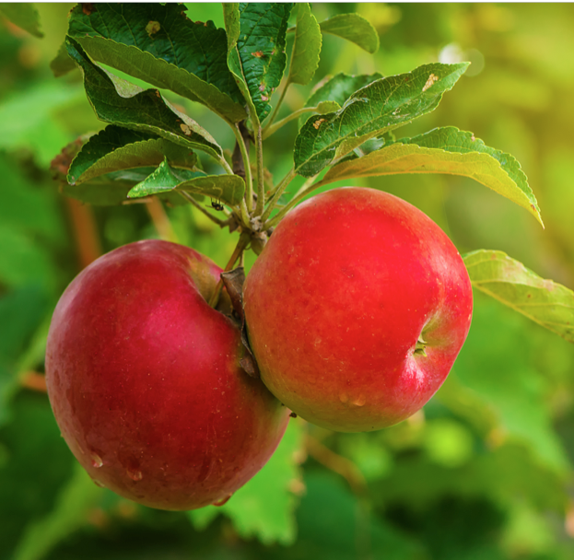
Higher Quality Food
(Review)
Who can tell us the TWO things that make a food high quality? List HQ to LQ:
Whole Apple
Apple Juice
Apple Sauce
Apple O’s Cereal
*Which item (s) above has been minimally processed?

Slide 4
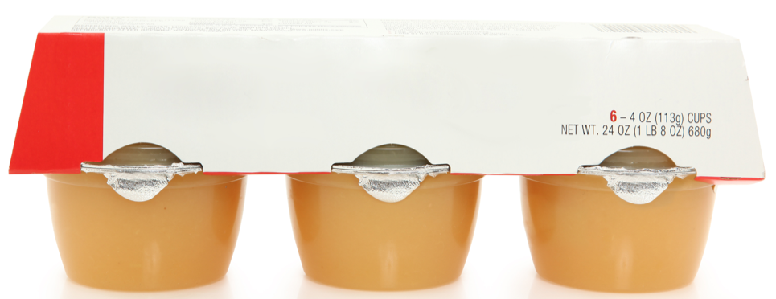
Question: What happens to food when it is processed?
Apple O’s Cereal vs. Apple Sauce
Which one is minimally processed?
Which one has more nutrients such as vitamins, minerals and fiber?
Which one most likely does not have a “whole” apple in it?

Slide 5
Food Investigators
Today we are going to learn how to use a food label to decide if a food is high in quality and close to its source.
ACTIVITY #1
Wheat Bread Activity

Slide 6
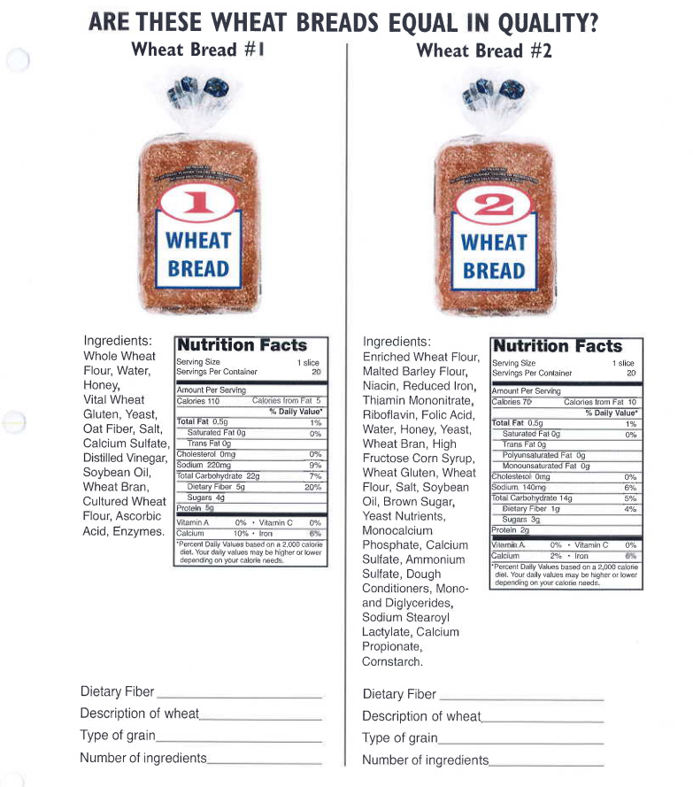
A food investigator gets clues about their
food from 2 different places.
Nutrition Facts
And
Ingredient List
➔

Slide 7
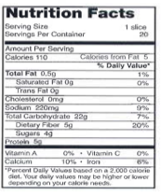
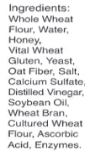
Nutrition Facts or Ingredient List
One of these two items tells us in detail what is actually in our food.
Nutrition Facts? Or Ingredient List?

Slide 8
FACTS
The “ingredient list” details all the things the food manufacturer uses to make the food.
The “nutrition facts” are the other part of the food label that tells us more information about the food.
The “nutrition facts” explains the different types of nutrients that are contained in a food such as how many grams of protein, fat and carbohydrates.
“Nutrition facts” also list a serving size. What is the serving size of one slice of bread? (activity)

Slide 9
What fuel type is bread?
P, F, or C?
FIBER IS GOOD!
We want a lot of fiber!
Activity: Nutrition Facts
1.) Put finger on “Total Carbohydrate”
2.) How many grams?
3.) What are the two facts under “Total Carbohydrate?
4.) How much FIBER in a SERVING?
5.) Write down number on sheet
Activity:
Ingredient List
1.) Ingredients are
Listed by weight from the greatest to least.
2.) Listed from heaviest to lightest.
3.) What should be the first ingredient in bread?

Slide 10
KEY FACTS
*HIGHER-QUALITY FOOD = FEW INGREDIENTS
*YOU SHOULD RECOGNIZE AND KNOW WHAT THE INGREDIENTS ARE IN YOUR FOOD

Slide 11
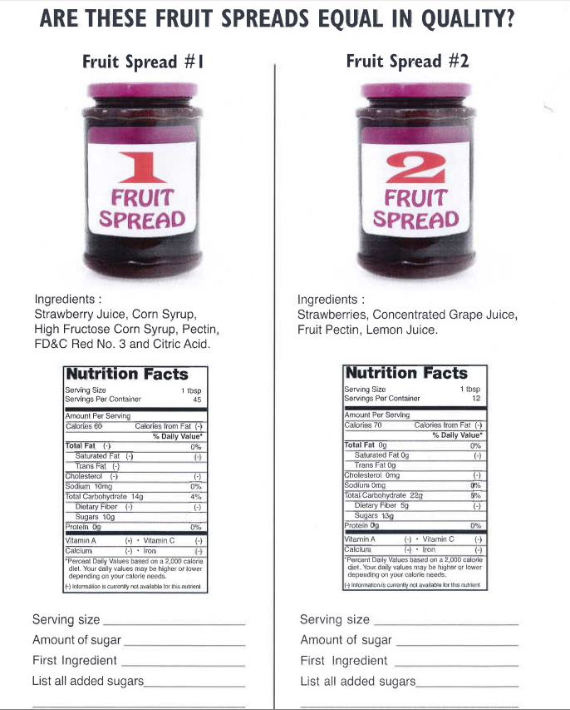
Let’s Investigate!
Packaged foods
containing fruit often have a fair amount of added sugars listed on the nutrition facts label.
What fuel type are strawberries?
P, F or C?
ACTIVITY:
Work with a partner and fill in the blanks at bottom of sheet.
Fill in:
Fill in:

Slide 12
Food Investigator REVIEW
Where do we find nutritional value of foods?
Where do we learn what is exactly in our food?
What clues help us determine a foods quality?

