Slide 1
Lesson #1
Feed Your Engines:
Proteins, Fats, and Carbohydrates

Slide 2
Hello!
What is GrowingGreat?
5 lessons this year
Our goals for you:
Understand that food is our fuel that keeps us performing at our best
Make little steps towards changing the foods you eat
Try new foods that are higher in quality

Slide 3
Fueling Up
What do you think of when I say “fuel” and “engine”?
What do your parents pump into their car to make it run?

Slide 4
Adventure Time!
4 volunteers who like to act
Let’s go on an adventure! Where should we go?

Slide 5
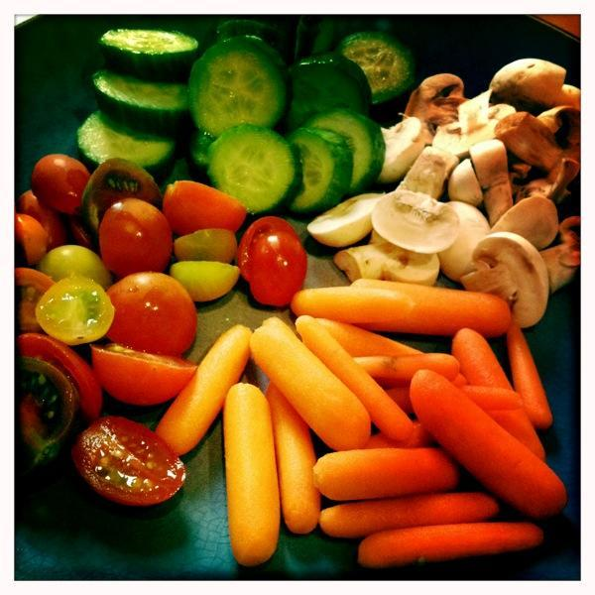
Feed Your Engines
Just like cars need fuel to run, so do our bodies.
What do we call the “fuel” that humans use for energy?
We need a combination of 3 types of fuels: proteins, fats, and carbohydrates = PFCs.
Variety = Healthy

Slide 6
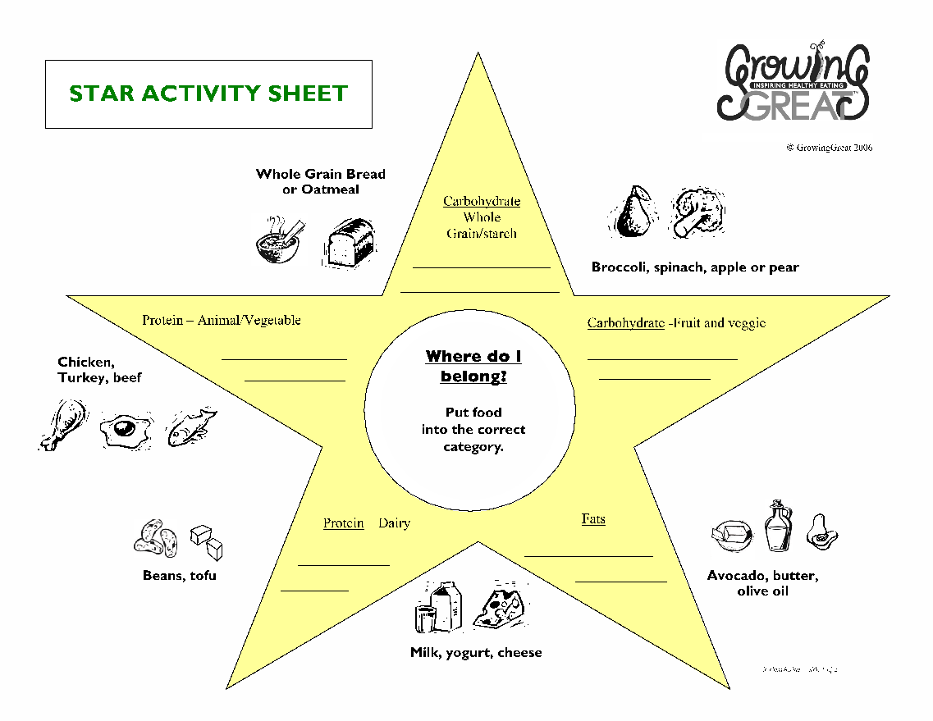

Slide 7
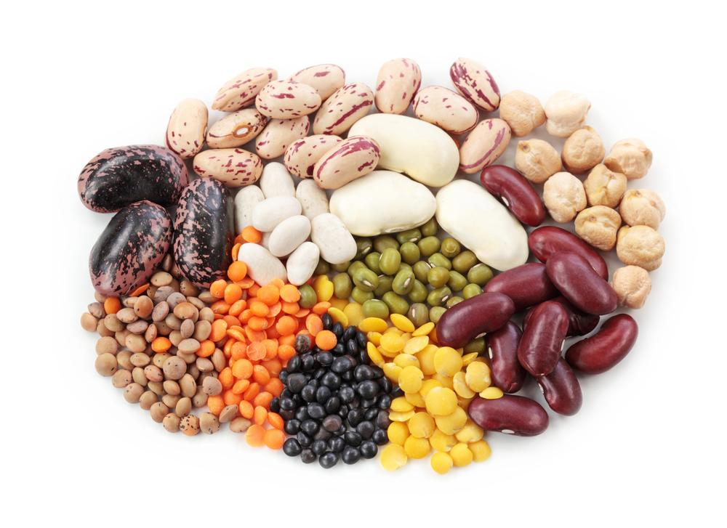
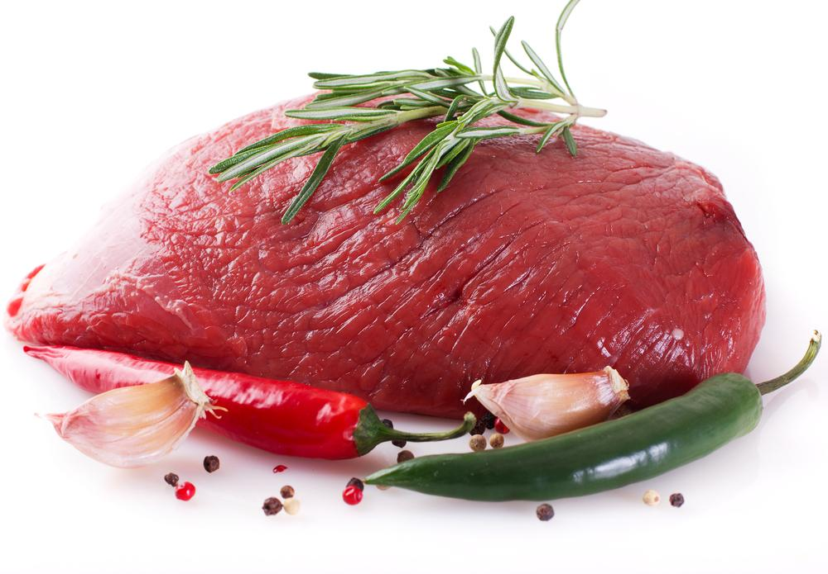
Proteins = GROW foods
Proteins help our muscles & tissues grow, & help our brains think clearly = GROW foods
2 different categories of proteins

Slide 8
Dairy Proteins
Examples?
How do dairy foods benefit our bodies?

Slide 9
Animal Proteins
Examples?
Benefits:
Provide vitamins, help muscles grow, and keep us feeling full

Slide 10
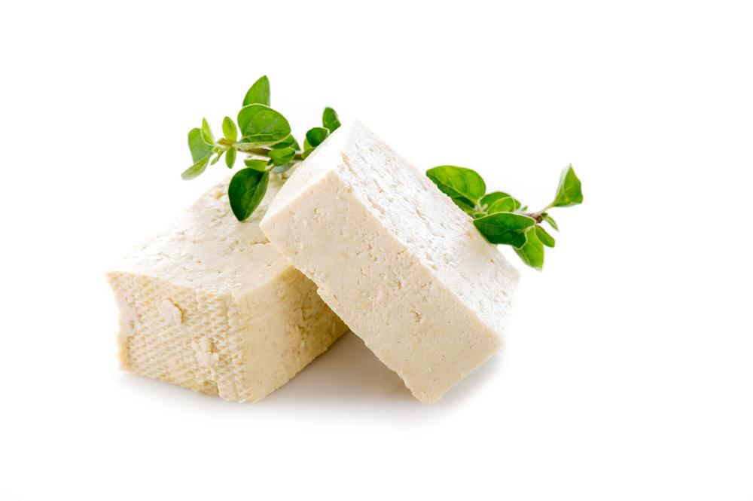
Vegetarian Protein
What does a vegetarian not eat?
Example of a vegetarian protein?
Do you need to be a vegetarian to eat vegetarian protein?
Variety is key!

Slide 11
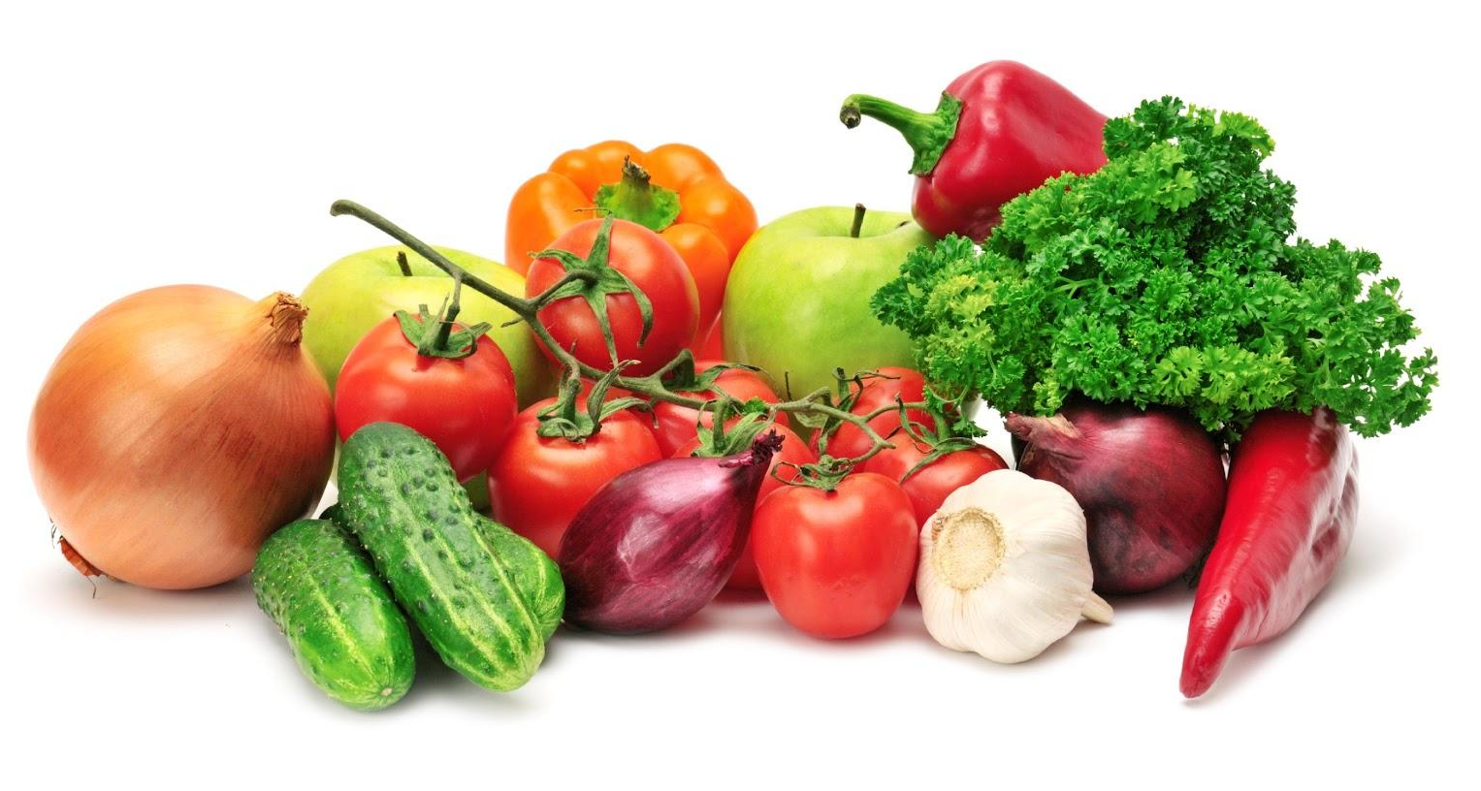
Carbohydrates = GO foods
Say it with me: CAR-BO-HY-DRATES
Carbohydrates give us quick and lasting energy = GO foods
2 categories: whole grains or starches, and fruits or vegetables

Slide 12
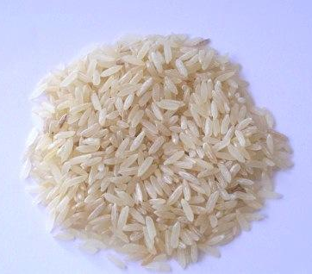
Grain Carbohydrates
What is a grain?
Can you name some?
Whole grains = long lasting energy

Slide 13
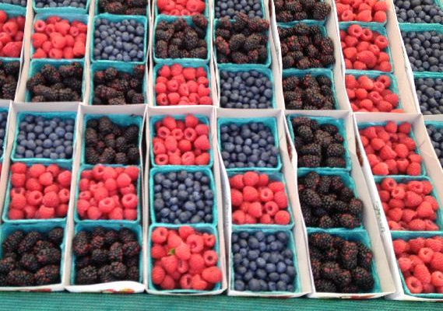
Fruit and Vegetable Carbohydrates
Example of a fruit carbohydrate?
Benefits of fresh fruit:
Vitamin C for immune system
Example of a vegetable carbohydrate?
Benefits of fresh veggies:
Fiber and vitamins

Slide 14
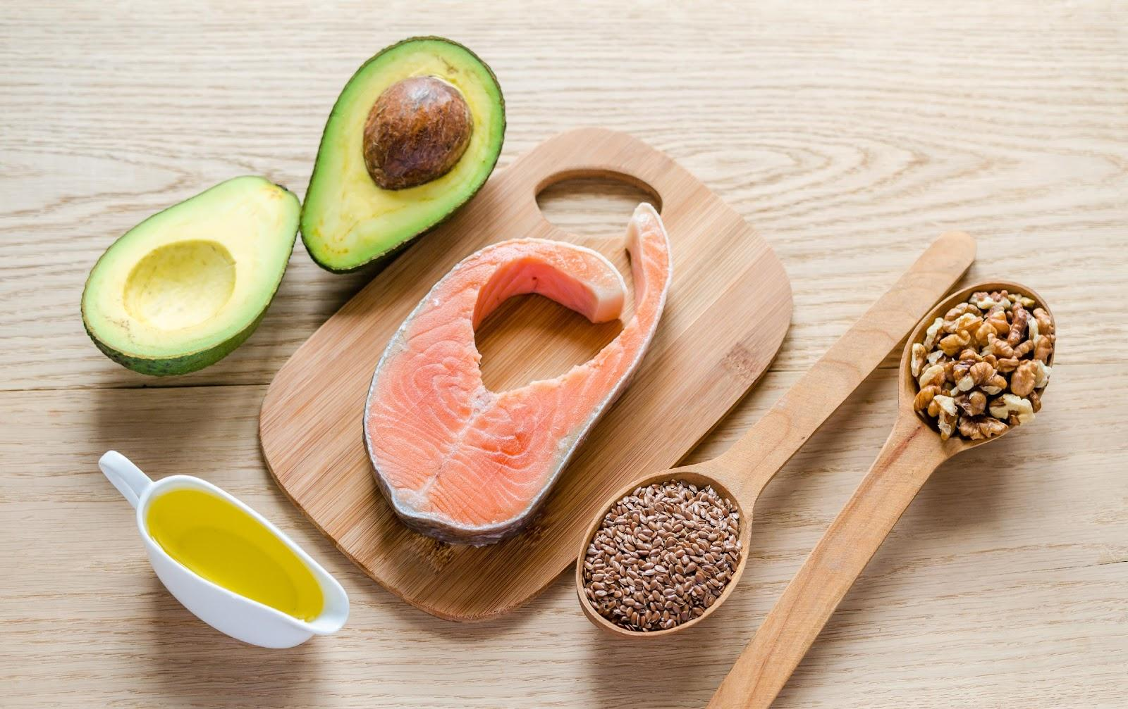
Fats = BRAIN foods
Are fats unhealthy?
Fats help us think and perform at our best = BRAIN foods
Harmful vs. beneficial fats
What does beneficial mean?
Examples of foods
that contain fat?
Hydrogenated oils

Slide 15
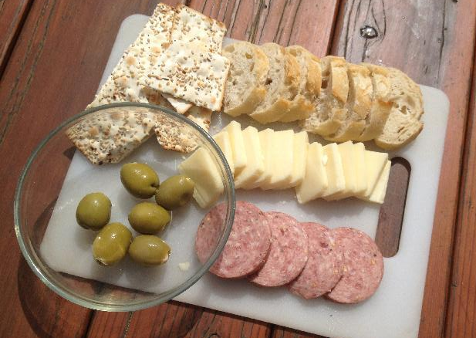
PFC snack
What snack could you eat at home that includes Protein, Fat, and Carbohydrate?
Where does each food item belong on the STAR chart?

Slide 16
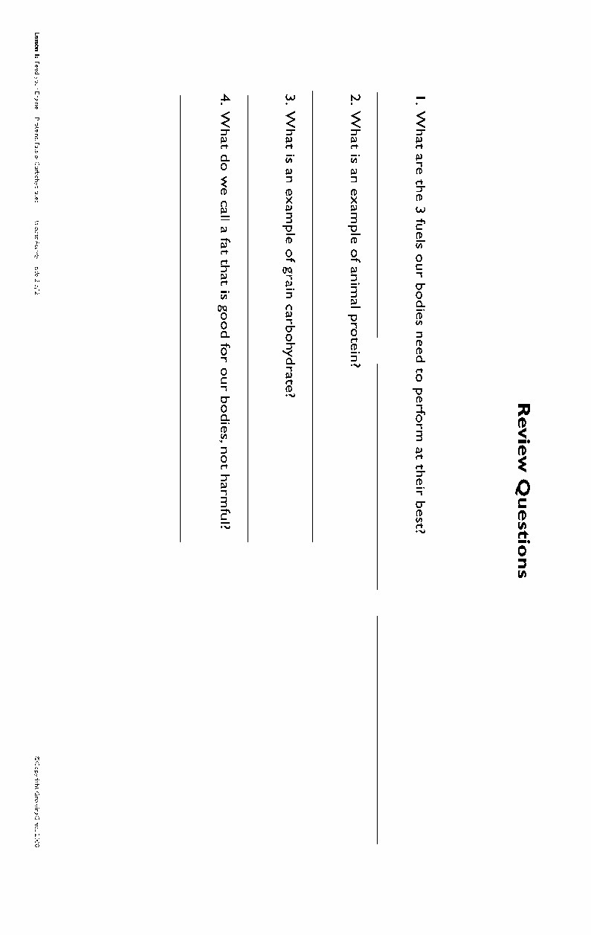

Slide 17
Review
It takes a combination of PFCs to help us perform at our best.
Eating a variety of foods from each category everyday keeps us healthy.
That’s our lesson! GREAT JOB!
THANK YOU!

